Slide 1
Texas CHARGERS Retreat 2020 Bulldog CHARGE Lab Updates
Kasee K. Stratton, Ph.D., NCSP
Associate Professor, Licensed Psychologist
Director, TK Martin Center for Technology and Disability
Mississippi State University

Slide 2
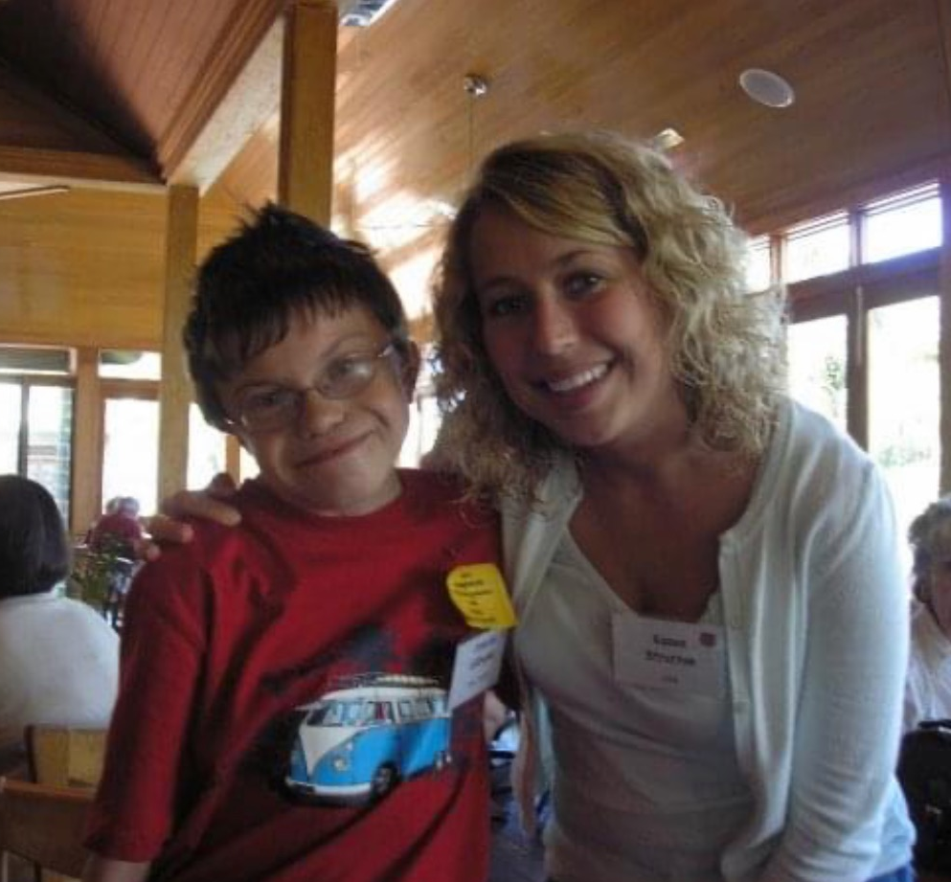
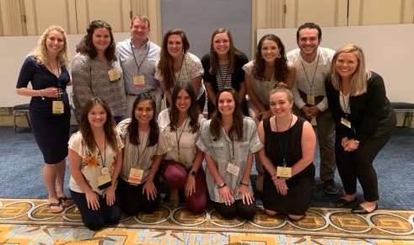
2006

Slide 3
Mission
Improve the quality of life of individuals with CHARGE and those around them. Emphasis: home, school, and hospital.

Slide 4
Research has been the foundation to our growth…
…through awareness, discovery, support for new families, and to answer the needs of today.

Slide 5
Average 14 studies a year

Slide 6
medical
education & behavior
genetics
diagnosis
comorbid conditions

Slide 7
”My Child Has an IEP”
Involved.
Educated.
Parent.

Slide 8
IEPs: Are Parents Satisfied?
Approx. half of parents indicated that they were satisfied with the various aspects of the IEP meeting and accommodations
Only 70% of the IEPs had 100% measurable goals, indicating that the quality of the other IEPS were unsatisfactory.
Bulldog CHARGE Research Lab

Slide 10
Features of a Measurable Goal
How is your child currently performing and how does that map onto the goal?
Description of desired behavior
Should list the time period across which the goal is being measured/when it should be met by
Should contain a desired percentage of accuracy and number of trials/opportunities required to be presented
What makes up a trial?

Slide 11
Features of Measurable Goals (cont.)
Goals should change each year
If met, does the criteria for the goal need to be increased or do we need a new goal?
Ask staff how they intend to measure the goal
Would they be able to teach you how?

Slide 12
CHARGE Educational Checklist
Slavin & Hartshorne (2019)
Comprehensive tool outlining:
CHARGE Characteristics
Team Members
Consulting Professionals
Methods of Accommodation

Slide 14
behavior

Slide 15
Purpose
The purpose of this research was to examine the nature of self-injurious behavior in individuals with CHARGE syndrome in order to identify similarities within this population
Function
Topography
Severity
Frequency
Body Site

Slide 16
Method

Slide 17
Method
Caregivers of individuals with CHARGE were asked to complete an online survey
The survey included:
Demographic information
If individuals identified the occurrence of self-injury, follow up questions were provided
Treated by a medial or behavioral professional
Use of medications
Age individual began to engage in SIB
SIB likelihood during painful illness or experience
Engagement in SIB in the last two months
The Behavior Problems Inventory (BPI), Self-Injurious Behavior Subscale
Body site preference
Functional Assessment Screen Tool-Revised (FAST-R)

Slide 18
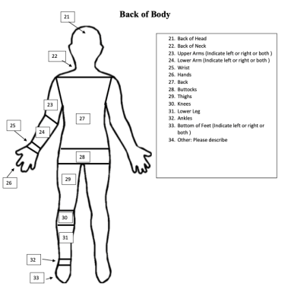
Method

Slide 19
Results

Slide 20
Demographics
Number of Participants
91

Slide 21
Results – Preliminary Data

Slide 22
Preliminary Data
81%
43%
72%
self-scratching
teeth-grinding
51%
self-biting
63%
body hitting
head hitting
19%
vomiting

Slide 23
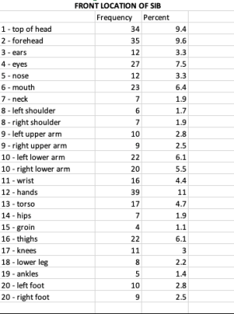
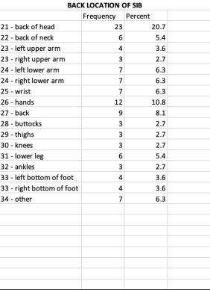
Results – Preliminary Data

Slide 24
Functions of SIB
Attention
The behavior usually occurs in your presence or in the presence of others

Slide 25
Functions of SIB
Access
When the behavior occurs you often respond by giving a specific item

Slide 26
Functions of SIB
Escape
The behavior occurs during training activities or when asked to complete a task

Slide 27
Functions of SIB
Sensory
Behavior occurs at high rates regardless of what is going on in the immediate surrounding environment

Slide 28
Discussion
Although data are still being analyzed, preliminary findings suggest that there are similarities of self-injurious behavior among individuals with CHARGE
Such findings could be beneficial for directing strategies for treatment
Identify those at risk for SIB and intervene as early as possible
Future research should continue to investigate the role of SIB in relation to painful experiences

Slide 29
Seeking Participants SOON!
Parent training for identifying function of behavior
Several online meetings
Requirements: Parent of an individual with CHARGE who exhibits behavior at home, having access to high speed internet and having access to a personal laptop or desktop computer.
Formal call for participants will be announced soon!

Slide 30
PTSD in CHARGE
Currently recruiting!

Slide 31
Adulthood

Slide 32
Exploring Attitudes of Sexuality
Mathis (2020) Dissertation
Attitudes Towards Sexuality Questionnaire
Results:
Both parents and adults with CHARGE found to have relatively positive attitudes of sexuality
Statistically significant differences found in the areas of parenting and self-control

Slide 33
Sexuality Information
95%: an educator (e.g., teacher, coach, principal, school nurse; n=23)
58%: parents (n=14)
29%: a friend (n=7)
12%: a doctor (n=3)
Parenting:
Adults w/CHARGE had more positive views
More complex area of sexuality
Self-control:
Parents held more positive views

Slide 34
Future Directions: Adulthood
Romantic Relationships
Vocational Goals
Independent Living
Opportunities for higher education, technical schools
Advocating on the job
Identifying physicians
Locating adult services
Social isolation

Slide 35
Contact Information
Dr. Kasee Stratton
kstratton@tkmartin.msstate.edu
662-325-5461
@BulldogCHARGE
@BulldogCHARGElab
weringtrue.msstate.edu/charge

