Slide 1
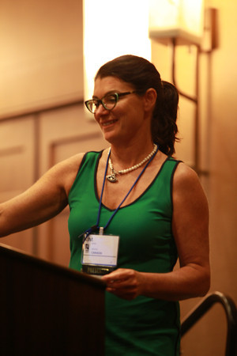

CHARGE
The Hidden Medical Issues
!
Dr. Kim Blake
Professor Pediatrics
IWK Health Centre and Dalhousie University
kblake@dal.ca
Navasota, Texas Nov. 2013

Slide 2
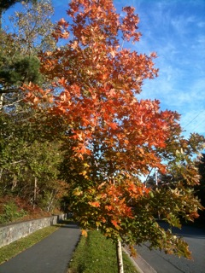
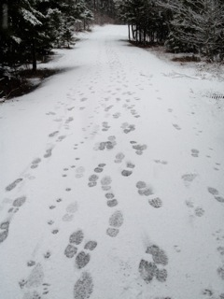

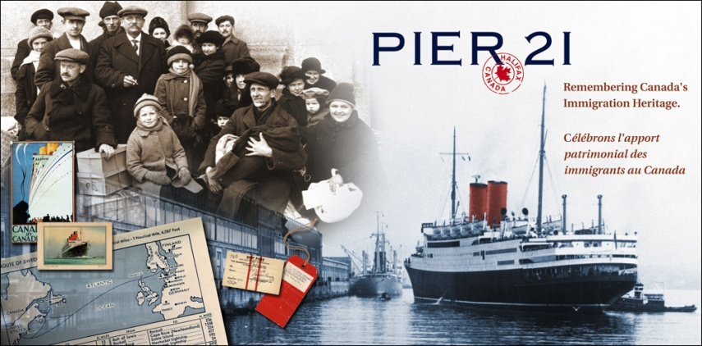
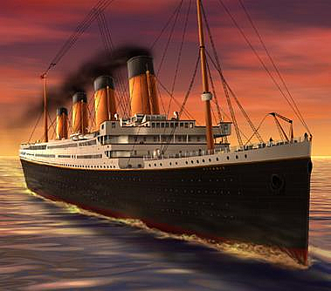

Halifax, Nova Scotia, Canada

Slide 3

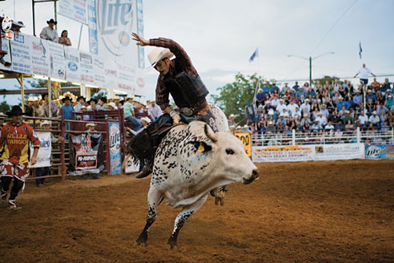
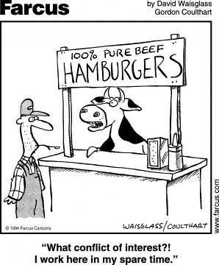
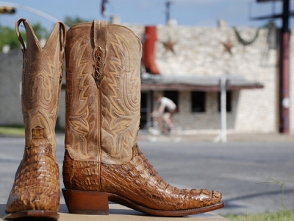
Navasota, Texas, US
No conflict of interest

Slide 4
Objectives
After this workshop you will understand many of the hidden medical aspects of CHARGE Syndrome including:
  Feeding issues
  Cranial nerves anomalies
  Obstructive sleep apnea and post-operative airway events.
  You will be more aware of bone health and puberty issues.
  We will share many stories and learn from each other

Slide 5
Let’s Rate Your CHARGEr’s Eating Difficulties Over the Years
0 | 1 | 2 | 3 | 4
None | A little (reflux, choking, no G or J tubes) | G or J Tube, less than 12 months | G or J tube feeding more than 12 months | Extension difficulties, one of the biggest problems

Slide 6
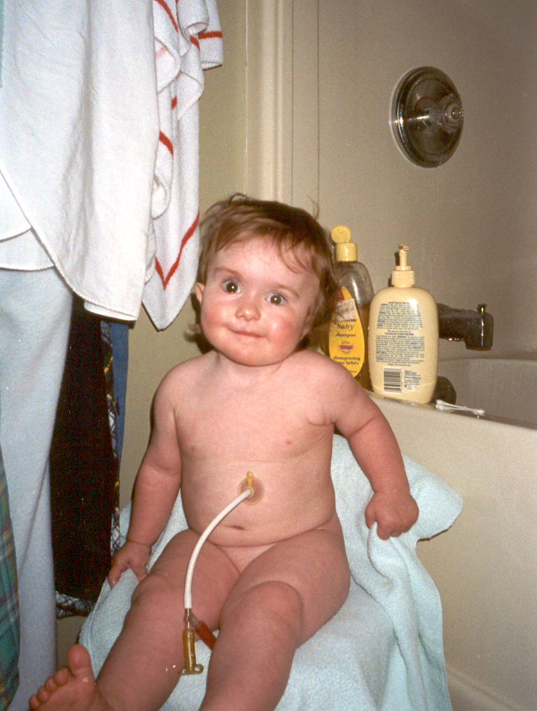
CASE HISTORY
4 Major & 3 Minor
MAJOR
C – Coloboma [Left Eye]. C - Choanal Atresia [Right]. C - Cranial Nerves [VII (Right), VIII, IX, XI]. C - Characteristic Ears [Severe SNHL].
MINOR
C - Cardiac - aberrant subclavian artery, bicuspid aertic valve. C - Characteristic CHARGE face. D – Developmental delay – balance, expressive speech.
M.C.

Slide 7
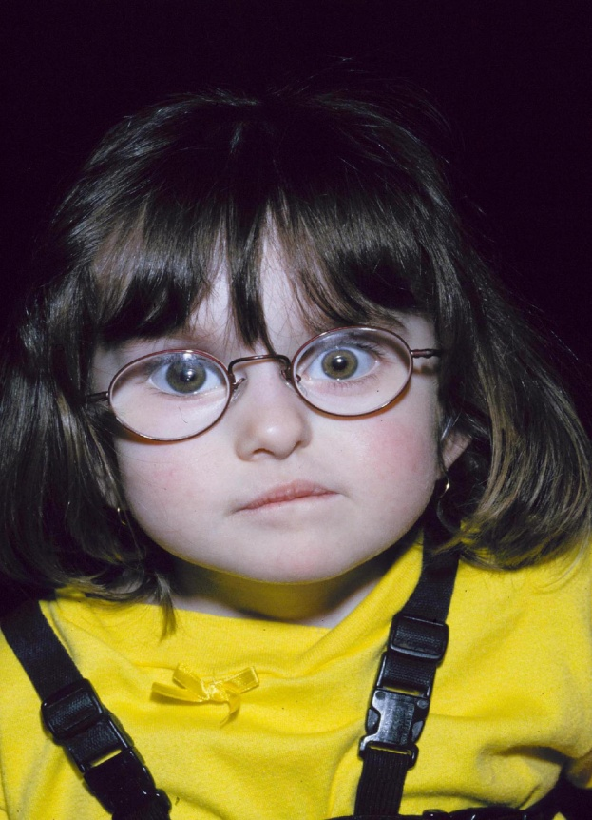
Hidden Structural Problems
CASE HISTORY
Feeding Issues
Severe renal hydronephrosis
Abnormal temporal bones
Cochlear transplant 2000
Nissens fundoplication and tonsillectomy 2001
Blake et al 1998 CHARGE Association - An update and review for the primary Pediatrician.

Slide 8
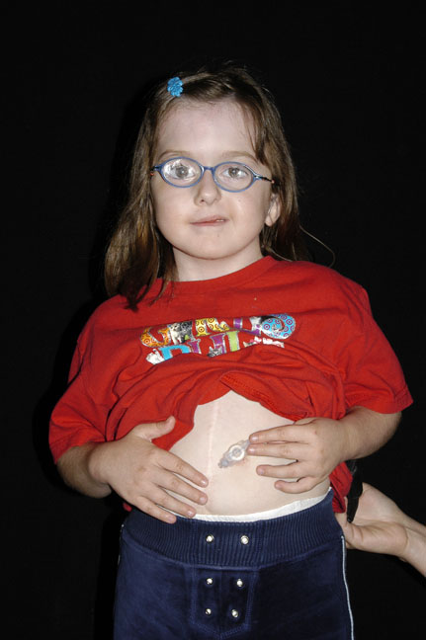
Feeding Issues
Poor sucking and swallowing
Velopharyngeal in-coordination
Gastroesophageal Reflux (GER)
Dobbelsteyn C, Blake KD. 2005. Early Oral Sensory Experiences and Feeding Development in Children with CHARGE Syndrome: A Report of Five Cases. Dysphagia. Vol : 89-100.

Slide 9
Feeding Question #1
“My 2 year old has been getting more picky and will not eat lumps. We never needed a tube but she’s losing weight and now has regular hiccups. She was on ranitidine as an infant but we weaned her off this.”
The family doctor feels that this is just the terrible two’s and not to worry.
Cindy Dobbelsteyn, et al. Feeding Difficulties in Children with CHARGE Syndrome: Prevalence, Risk Factors, and Prognosis. Dysphagia. 2008 Vol. 23, No. 2, p. 127

Slide 10
Treatments for Gastroesophageal Reflux (GER)
Behavioral treatment – raising the bed, small frequent meals, limiting foods that promote reflux such as tomatoes, meat, chocolate.
Medical management
  ranitidine 8mg/kg per day in 1-2 divided doses (for babies 3 divided doses)
  Prevacid (lansoprazole)- 1-2 mg/kg per day at the beginning of the day (occasionally twice a day)
  Domperidone (Motilium) – 4 times a day before meals
Also consider cow’s milk protein intolerance

Slide 11
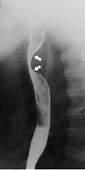
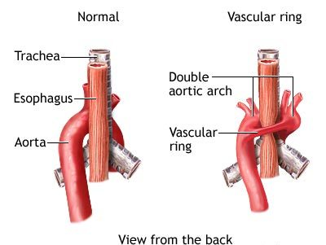
Discussion From the 11th International Conference Arizona.
“My adolescent with CHARGE Syndrome was having more problems with swallowing and what sounded like reflux but the food kept getting stuck, and she was complaining of pain. Eventually the doctors did a barium swallow and found a vascular ring that had been missed.”
Vascular Ring
Barium Swallow

Slide 12
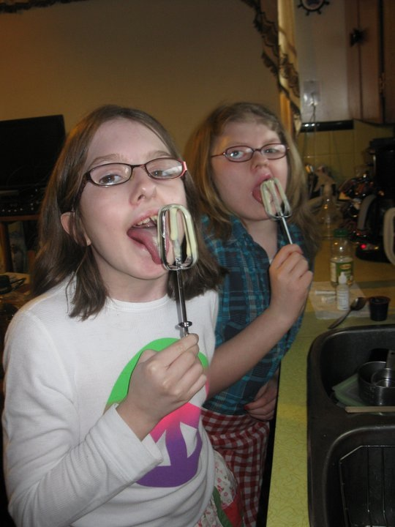
Feeding Question #2
After gastrostomy removal some children cram their
mouths with food, why?
oral hyposensitivity
Need for substantial amount of food in mouth before bolus preparation occurs
Two friends having lunch.

Slide 13
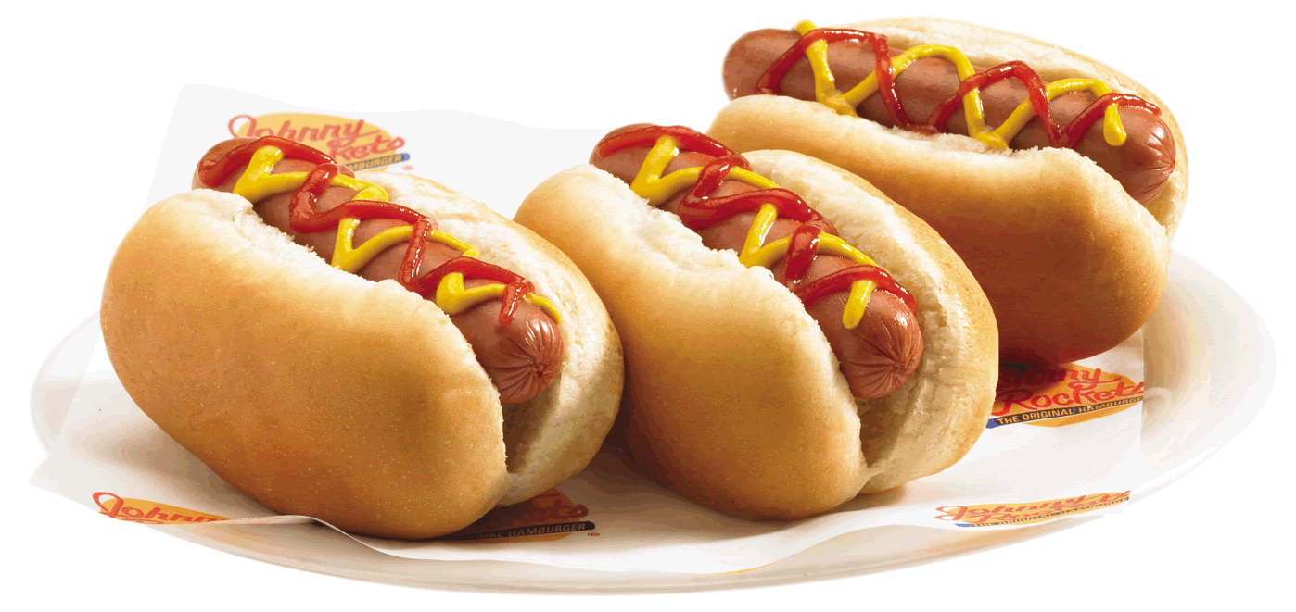
“Hot Dog in 3 Seconds Flat”
Ate quickly and swallowed without chewing

Slide 14
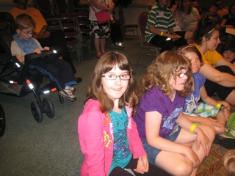
Ideas for Treatment
- external pacing - Therapist
- small manageable bites
- wait until mouth is clear before offering more

Slide 15
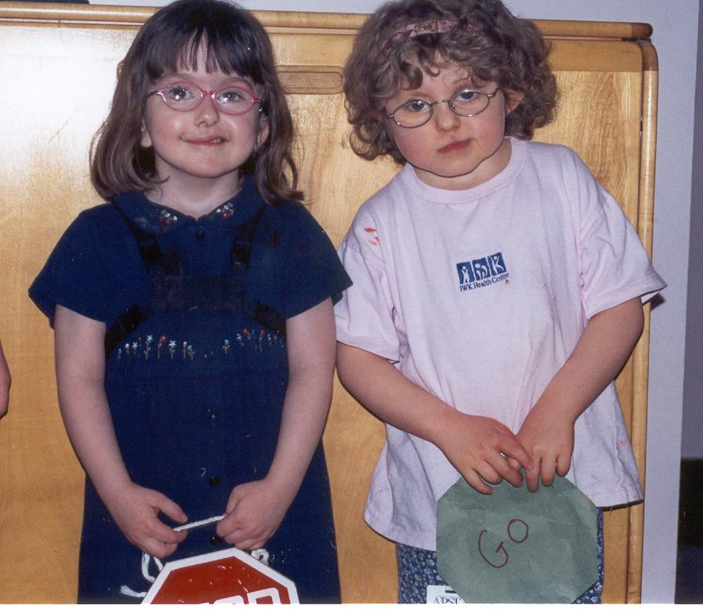
Any Questions on Feeding

Slide 16
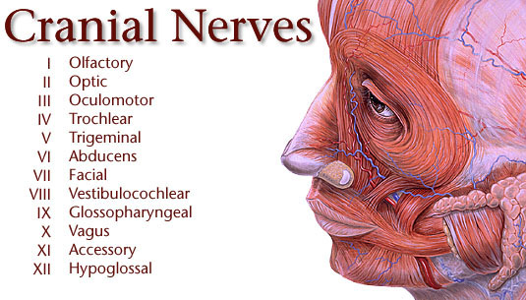
Yale Center for Advanced Instrumental Media’s Web Site: http://info.med.yale.edu/caim/cnerves

Slide 17
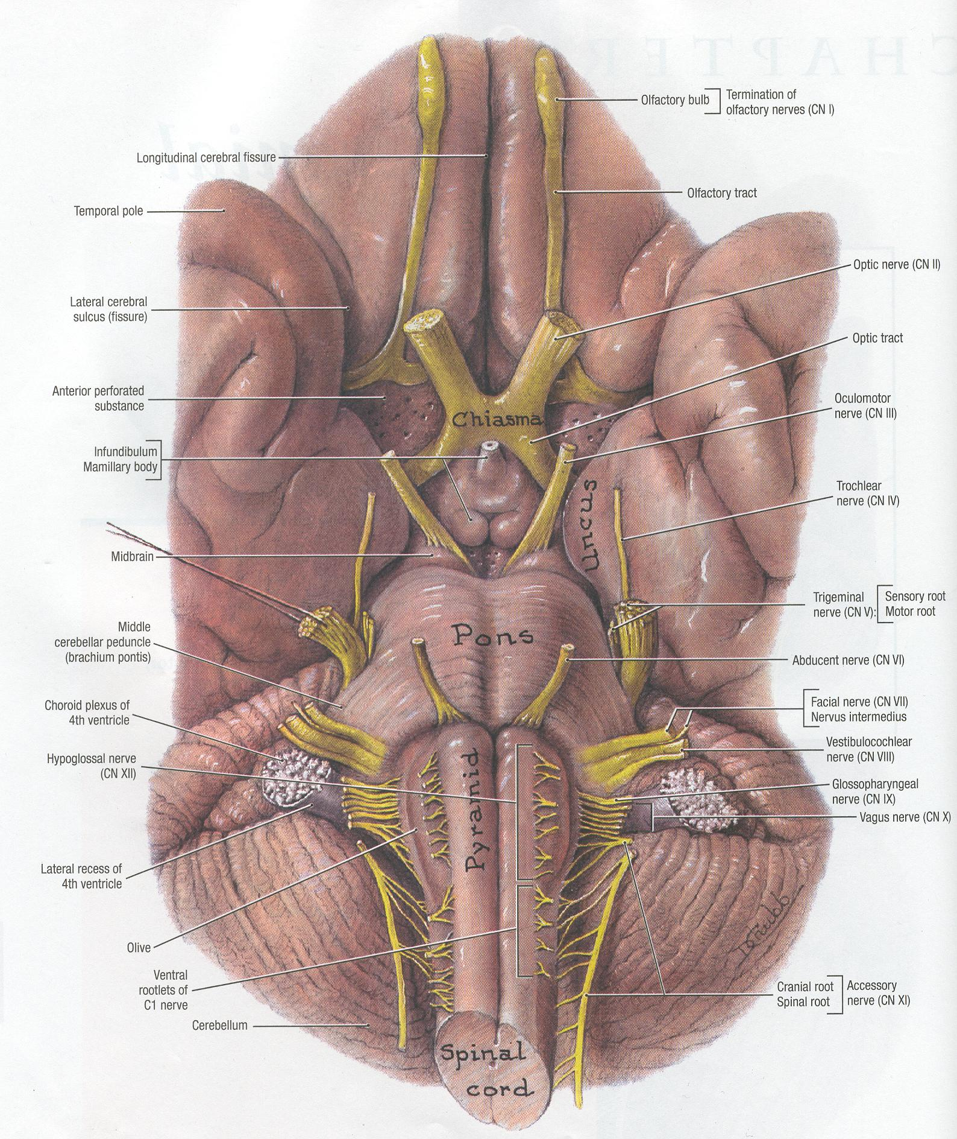
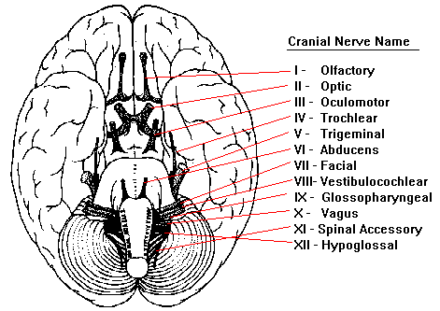
Cranial Nerves Arising from Base of Brain
Tenth Edition Grant’s Atlas of Anatomy

Slide 18
Cranial Nerves – 12 Pairs
Motor & Sensory
I Smell - anosmia
II III IV VI Eye movement
V Weak chewing & sucking, migraines
VII Facial nerve weakness
VIII Hearing & balance problems
IX X Internal organs (heart, gut)
XI Shoulder movements
XII Tongue
Blake KD, et al. Cranial Nerve manifestations in CHARGE syndrome. Am J Med Genet A. 2008 Mar 1;146A(5):585-92.

Slide 19

How many of you have CHARGEr’s with suspected cranial nerve problems?
No
1
2
3
More
CHARGE hands up

Slide 20
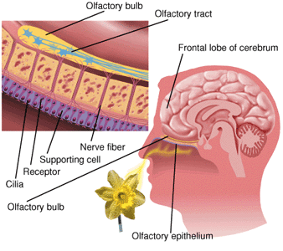
Olfactory Nerve (CN I)
There is a test kit available
Chalouhi C, Faulcon P, Le Bihan C, Hertz-Pannier L, Bonfils P, Abadie V. Olfactory evaluation in children: application to the CHARGE syndrome. Pediatrics 2005

Slide 21
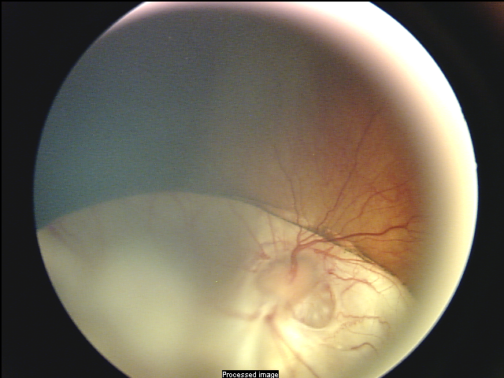
Retinal Nerve Coloboma
The Cranial Nerves of the Eye
II | Optic
III, IV, VI | Eye muscle movement
In CHARGE syndrome visual perception (II) affected, less often eye movement.
McMain K, Blake K, Smith I, Johnson J, Wood E, Tremblay R, Robitaille J.
Ocular features of CHARGE syndrome. 2008 Oct;12(5):460-5.

Slide 22
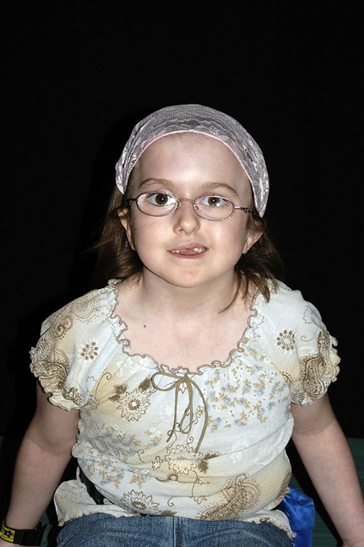
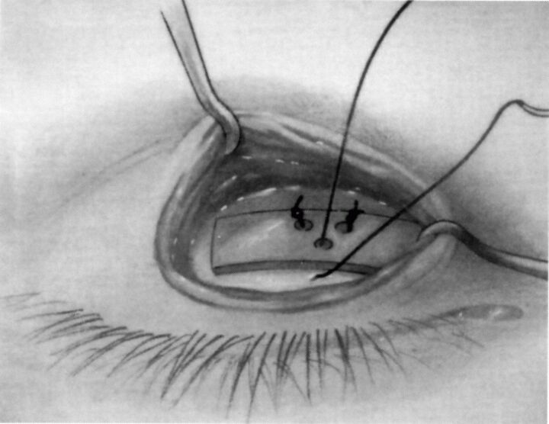
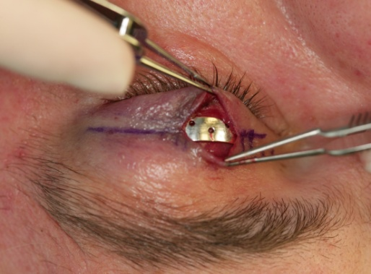
Eyes are at Risk With Facial Palsy
Dry eye
Damaged cornea
Light sensitivity
Using weights in the eyelids

Slide 23
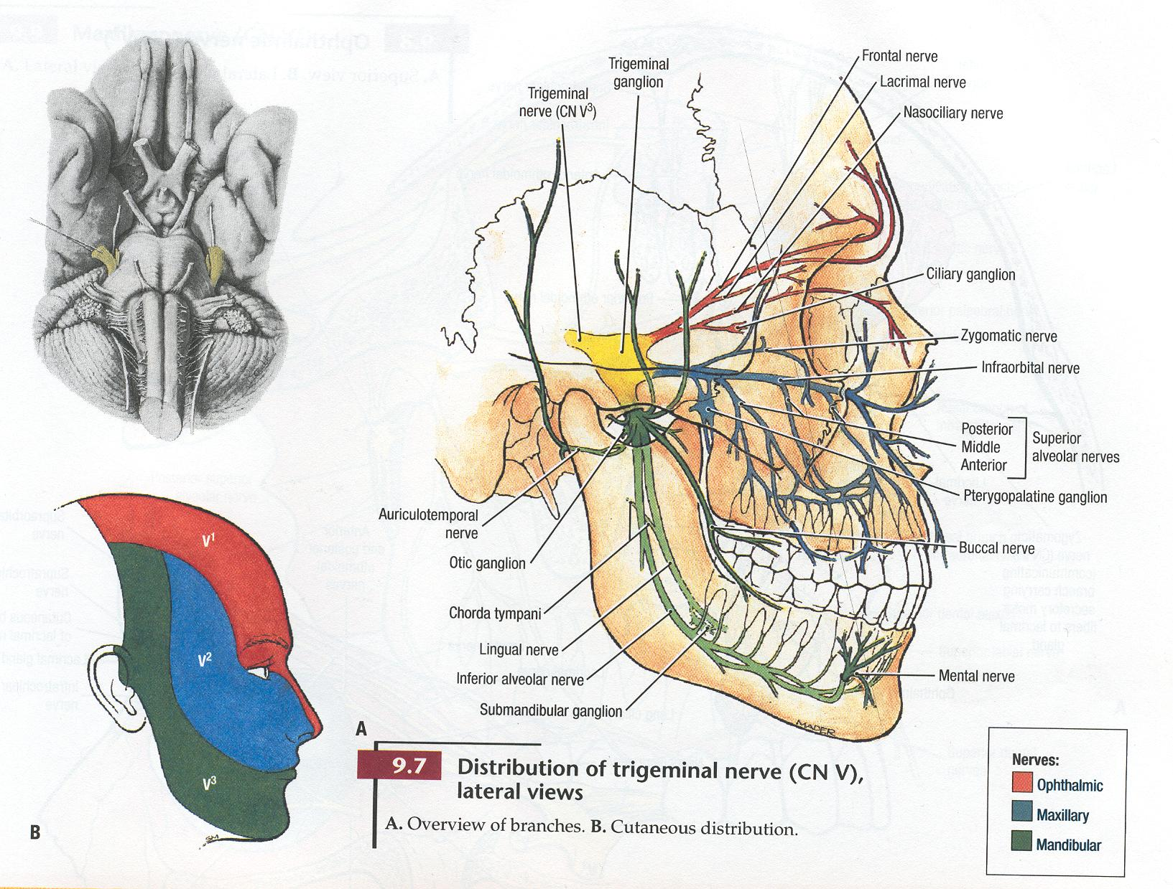
Trigeminal Nerve (CN V)
Tenth Edition Grant’s Atlas of Anatomy

Slide 24
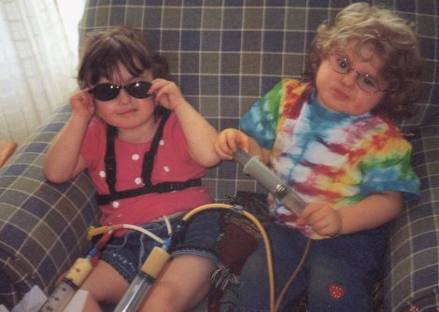
Feeding issues are often severe.
Muscles of Mastication – Cranial Nerve V
Two friends, MC and KW, having lunch.

Slide 25
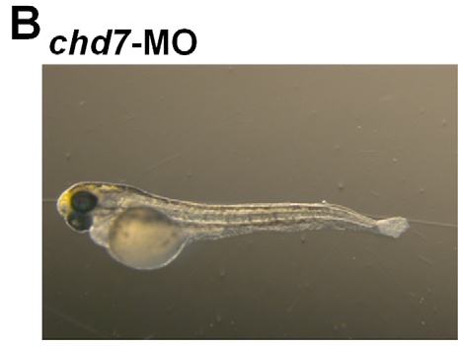
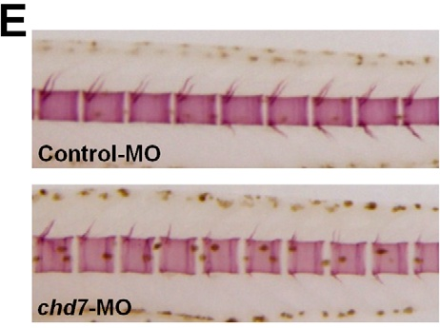
Role of Chd7 in Zebrafish: A Model for CHARGE Syndrome. PLoS One. 2012;7(2):
Patten SA, Jacobs-McDaniels NL, Zaouter C, Drapeau P, Albertson RC, Moldovan F.
Sainte-Justine Hospital Research Center, Montreal, Quebec, Canada.

Slide 26
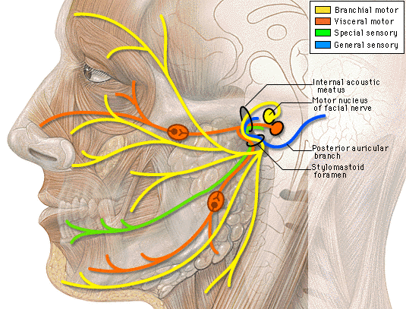
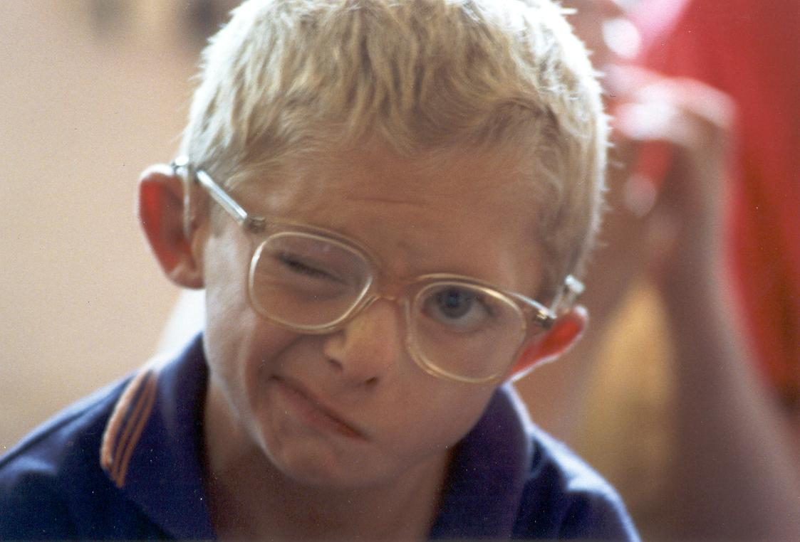
Cranial Nerve VII - Facial
Web Site: http://info.med.yale.edu/caim/cnerves

Slide 27
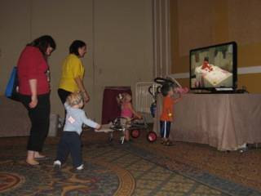
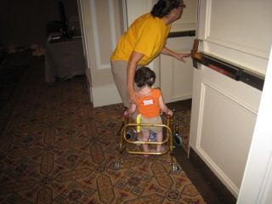
Mobility & balance in CHARGE has improved with physiotherapy
International CHARGE Conference 2011

Slide 28
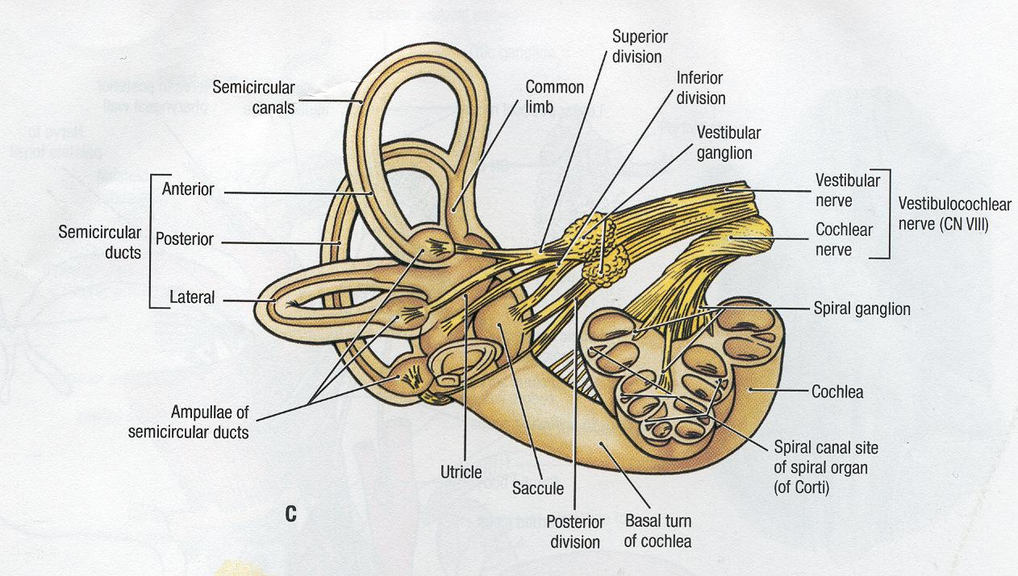
Temporal Bones – Balance & Hearing (CN VIII)
Tenth Edition Grant’s Atlas of Anatomy

Slide 29
Lower Cranial Nerves IX-XI
Cranial Nerve | Function | Symptom of Dysfunction
IX | Taste Salivation Swallowing | Gag reflex Swallowing
X | Phonation Swallowing | Gag reflex Swallowing
XI | Head and shoulder movement Laryngeal muscles | Shoulder drop Winging scapula
IX X XI Cranial Nerves – Abnormality in the supranuclear region.
Poor suck – swallow coordination, neonatal brain stem dysfunction (NBSD)

Slide 30
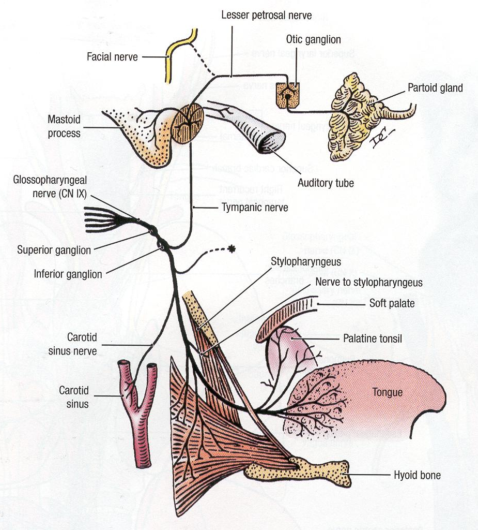
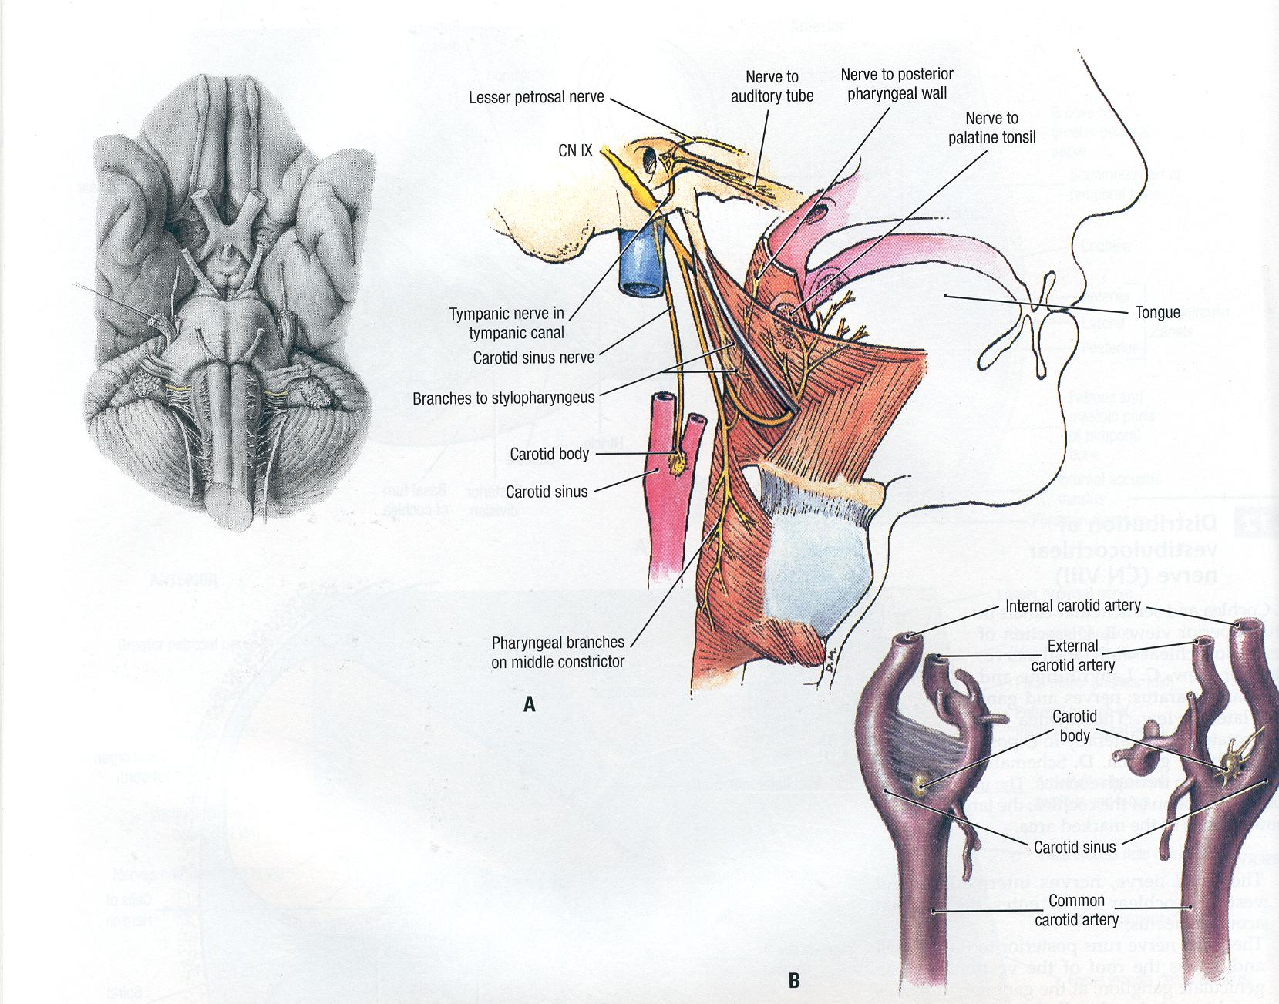
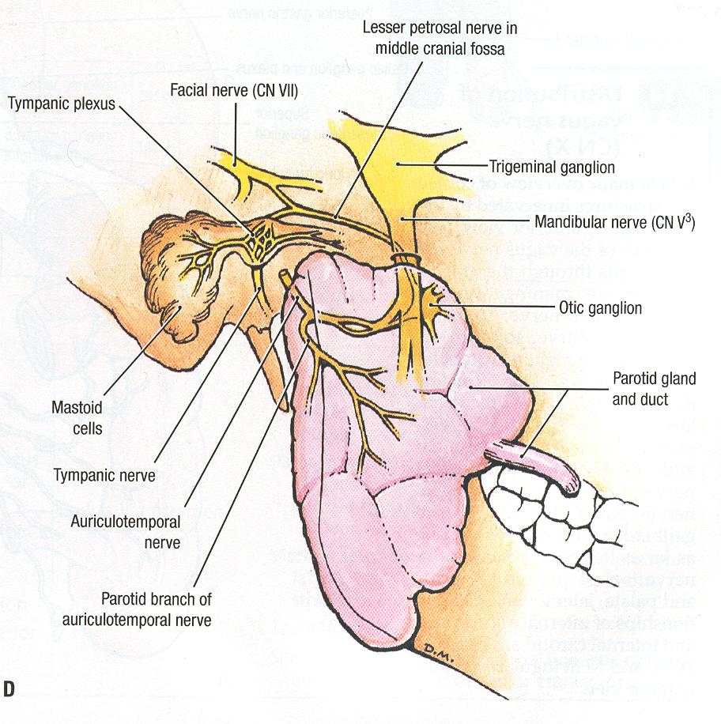
Cranial Nerve IX
Tenth Edition Grant’s Atlas of Anatomy

Slide 31
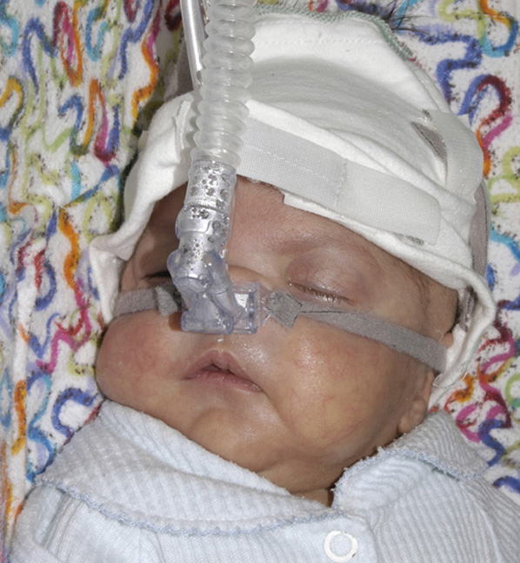
Frederick’s Story

Slide 32
“FREDDY” Early Days
Difficulty with intubations
TOF repair, vascular ring repair, PDA ligation
↑ secretions
Difficulty with extubation

Slide 33
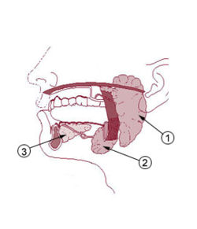
Site of Botox Injections
Parotid glands
Submandibular glands
Sublingual glands

Slide 34
Botox was Used for Increased Oral Secretions
Drooling, excessive secretions (sialorrhea)
Infrequent swallowing
Ineffective swallowing
Can be related to neurological conditions
?cranial nerve anomalies
Blake, Kim; MacCuspie, Jillian; Corsten, Gerard. Botulinum Toxin Injections into Salivary Glands to Decrease Oral Secretions in CHARGE Syndrome: Prospective Case Study.
Am J Med Genet A. 2012

Slide 35
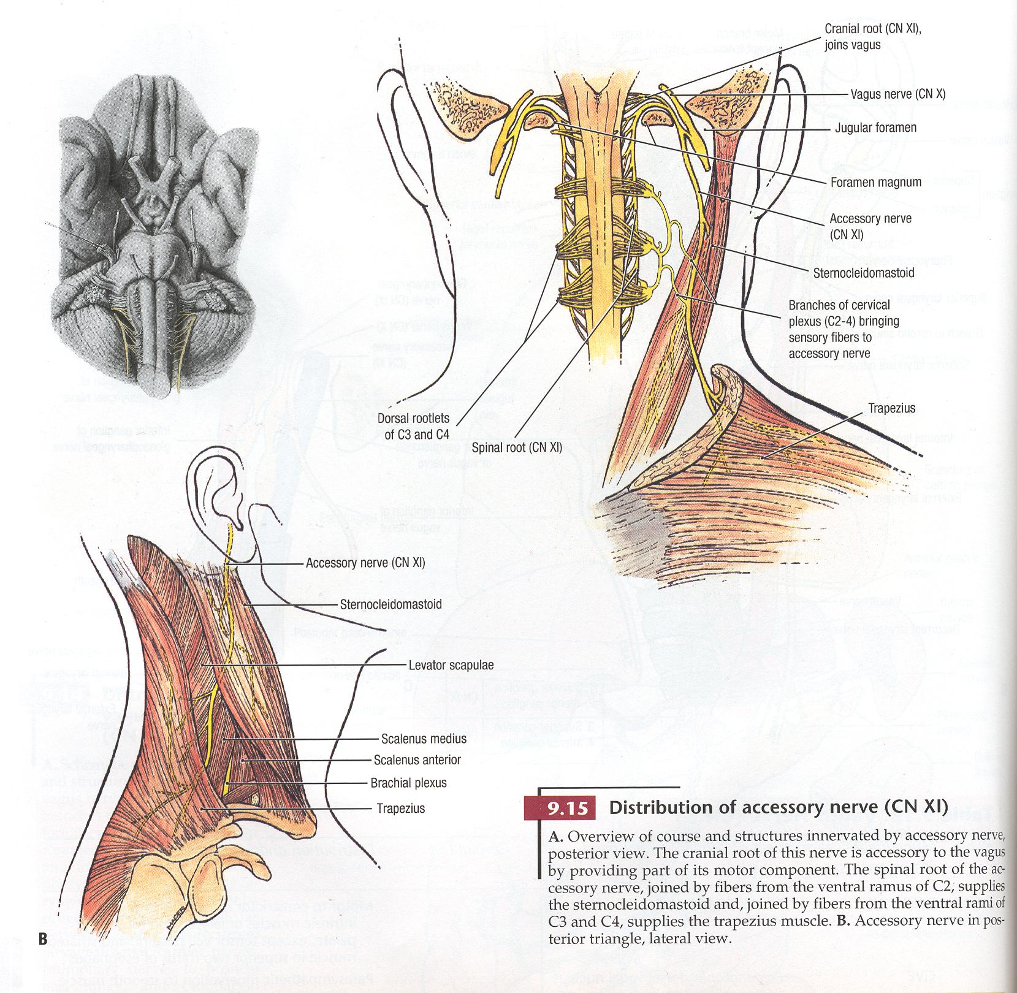
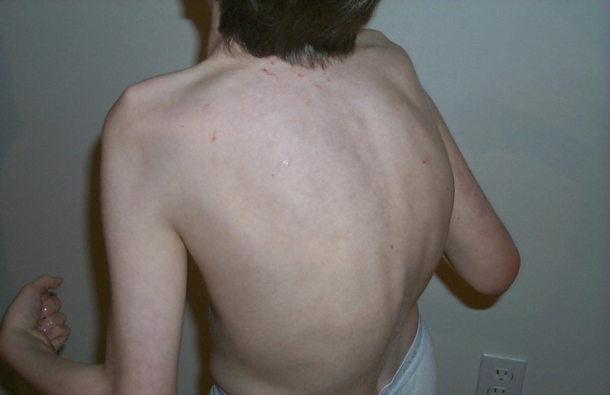
Accessory Cranial Nerve XI
Tenth Edition Grant’s Atlas of Anatomy

Slide 36
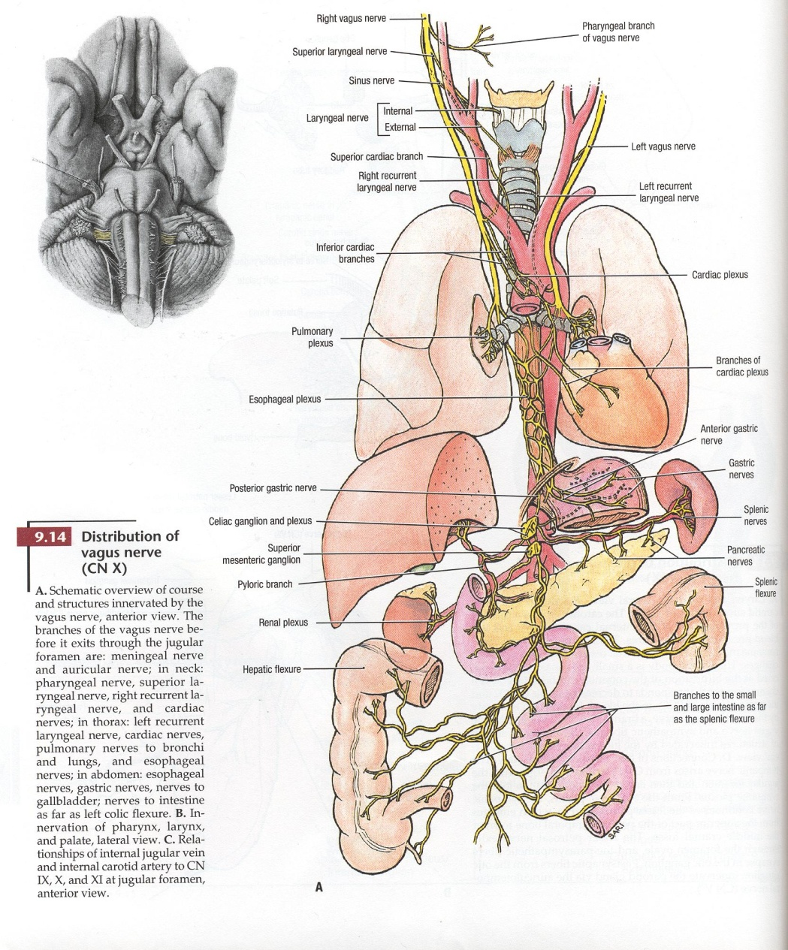
Cranial Nerve X
Vagus
Tenth Edition Grant’s Atlas of Anatomy

Slide 37
Summary of Cranial Nerve (CN) Findings in CHARGE syndrome
Dysfunction of cranial nerves is more frequent and multiple.
The extent and involvement of cranial nerves may reflect the clinical spectrum.
CN VII - is more frequently associated with other CN’s
- is seen in those individuals more severely affected.
CN V – “muscles of mastication” affected in CHARGE.
Structural brain malformations highly associated with CN.

Slide 38
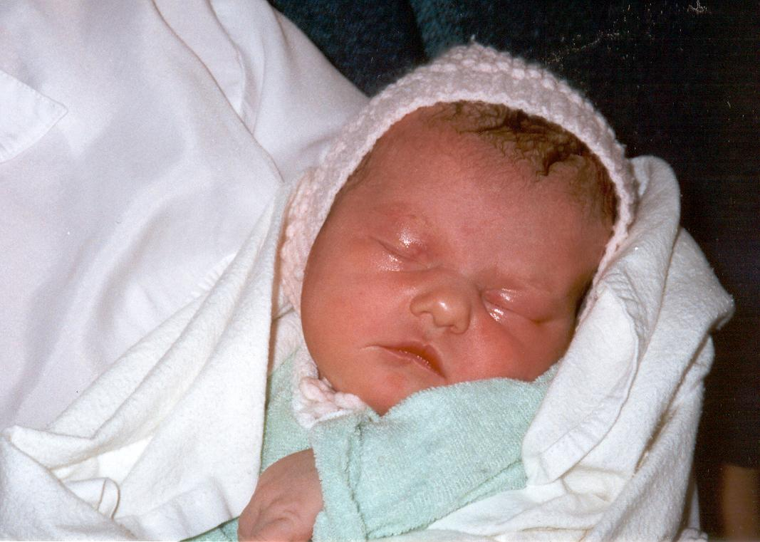
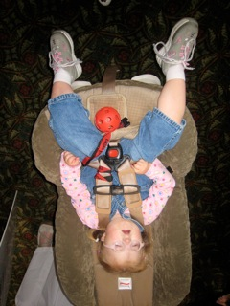
Obstructive Sleep Apnea and
Post Operative Airway Events
How many of you have sleep issues with your CHARGEr’s?

Slide 39
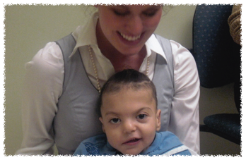
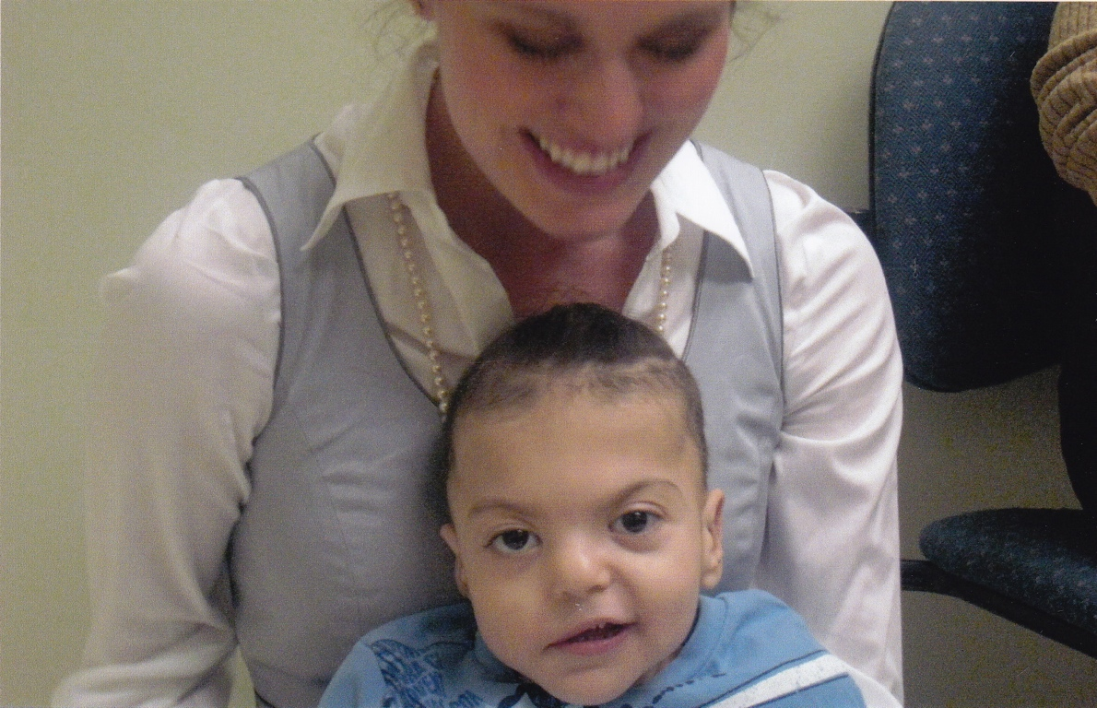
Obstructive Sleep Apnea
>50% children with CHARGE Syndrome have sleep related problems
Obstructive Sleep Apnea (OSA) - pauses in breathing, snoring, recurrent airway obstruction, daytime sleepiness
  Hypertrophy of adenoid and tonsillar tissue
To determine the prevalence of OSA
Apply two validated questionnaires to the CHARGE Syndrome population
Assess the quality of life after treatment for OSA
Trider CL, et al. Understanding Obstructive Sleep Apnea in Children with CHARGE Syndrome. International Journal of Pediatric Otorhinolaryngology, 2012

Slide 40
Methods
Subjects
  Children ages 0-14, diagnosis CHARGE Syndrome
Questionnaires
  CHARGE Syndrome Characteristics
  Brouillette Score
  Pediatric Sleep Questionnaire
  OSAS Quality of Life Survey2
Brouillette Score
Questionnaire / Observation
D. Difficulty in breathing during sleep?
0=never; 1=occasionally; 2=frequently; and 3=always
A. Stops breathing during sleep?
0=no; 1=yes
S. Snoring?
0=never; 1=occasionally; 2=frequently; and 3=always
Brouillette score = 1.42 D + 1.41 A+0.71 S -3.83
>3.5: diagnostic for OSA
Between -1 and 3.5: suggestive for OSA
<-1: absence of OSA
Try it out!

Slide 41
Results (N=51)
33 /51 = 65% of children had obstructive sleep apnea (OSA)
  10 treated with CPAP
  27 adenoidectomy +- tonsillectomy
  9 tracheostomy
Brouilette Scores for children before and after treatment for OSA
p<0.001
Brouilette Scores > 3.5 = OSA < -1 unlikely OSA

Slide 42
Results (n = 16)
Pediatric Sleep Questionnaire Scores
Symptom Category Subscale | Mean scores before surgery | Mean scores after surgery | P Value
Snoring* | 2.9 | 0.7 | <0.001#
Breathing problems | 1.8 | 0.6 | <0.001#
Mouth breathing | 1.3 | 1.0 | 0.104
Daytime sleepiness* | 2.6 | 1.7 | 0.011#
Inattention/hyperactivity* | 4.2 | 4.1 | 1.00
Other symptoms | 1.6 | 1.6 | 0.333
*Significantly associated with sleep related breathing disorders on their own
# Significant
Chervin RD, et al. Sleep Med 2000;1:21-32.

Slide 43
Discussion/Conclusions
There is a high prevalence of OSA in children with CHARGE Syndrome
Brouillette Scores can be used to identify OSA in CHARGE Syndrome
Pediatric Sleep Questionnaire may be useful when modified
OSA-18 questionnaire indicates that all treatments for OSA provide a large positive impact on health related quality of life
OSA = Obstructive Sleep Apnea

Slide 44
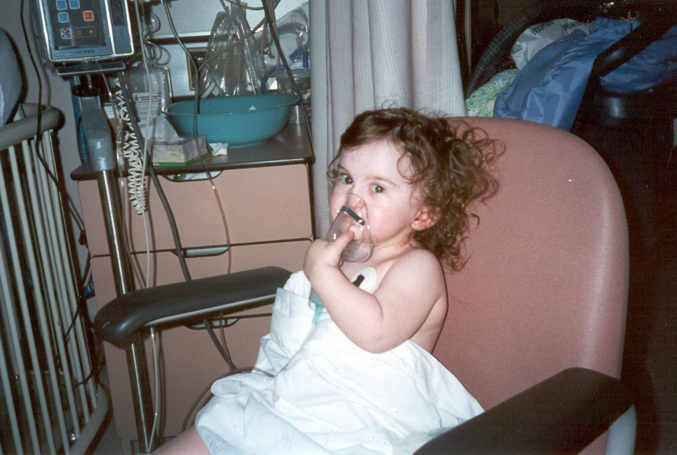
Post Operative Airway Events
MacKenzie’s Story
27 surgical procedures
18 anaesthesias
4 complications
Multiple ICU admissions

Slide 45
Methodology - 1
Detailed chart review 4 females, 5 males, mean age 11.8 yrs
  Surgeries (ears, diagnostic, digestive/feeding, nose, throat, dental, heart, eyes, other)
  Anethesias type/number
  Complications – major (reintubation NICU admission, minor (post-op cough, wheeze, crackles)

Slide 46
Methodology - 2
Results from 9 individuals
  218 surgeries
  147 anesthesias
Mean age first operation 8.8 months (range 3 days to 4 years)
Mean number of surgeries per individual 21.9 (+- 12.2)

Slide 47
Results
Type of Procedures | Number of Procedures | % Total
Ears | 47 | 22
Diagnostic | 44 | 20
Digestive/Feeding | 31 | 14
Nose/Throat | 30 | 14
Dental | 26 | 12
Heart | 20 | 9
Eyes | 6 | 3
Other | 14 | 6
Mean length of anesthesia 124 minutes (+- 31.6 minutes)

Slide 48
Single vs Multiple Procedures
Single | Multiple
39% | 27%
37/94 | 14/51
P>0.05

Slide 49
Results
35% (51/147) of anesthesias resulted in complications (>60% were major)

Slide 50
Results
Anesthesia related complications occurred most often with heart, diagnostic scopes and gastrointestinal tract.

Slide 51
Discussion
35% of anesthesia resulted in complications
Heart, diagnostic, gastrointestinal tract result in the most complications
A complication resulted at least once in every type of surgery except for eyes
K. Blake, et al., Postoperative airway events of individuals with CHARGE syndrome,
Int. J. Pediatr. Otorhinolaryngol. (2008)

Slide 52
Discussion
High risk of complications with individuals with Nissens fundoplication or gastrotomy/jejunostomy tube
Low risk cleft of a palate
What about individuals with CHD7 mutations, who have mild clinical criteria?
Will they be at risk in the future?
Have they actually been challenged with surgeries?

Slide 53
Conclusion
CHARGE individuals are at high risk of anesthesia complications especially post operatively. Combining procedures during one anesthesia does not increase the risk of anesthesia related complications. The anesthetist needs to be aware, but even with simple procedures the individual with CHARGE Syndrome is at high risk.

Slide 54
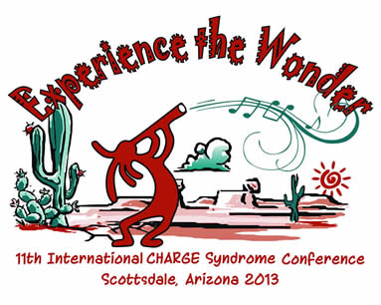
Bone Health – Not a Humerous Issue
Dr. Kim Blake
Professor, Dalhousie University
Halifax, NS, Canada
kblake@dal.ca
and
Dr. Jeremy Kirk
Reader, Diana, Princess of Wales Children’s Hospital
Birmingham, UK
Jeremy.Kirk@bch.nhs.uk

Slide 55
Osteoporosis
Why do I Need to Worry?
Two friends with CHARGE Syndrome

Slide 56
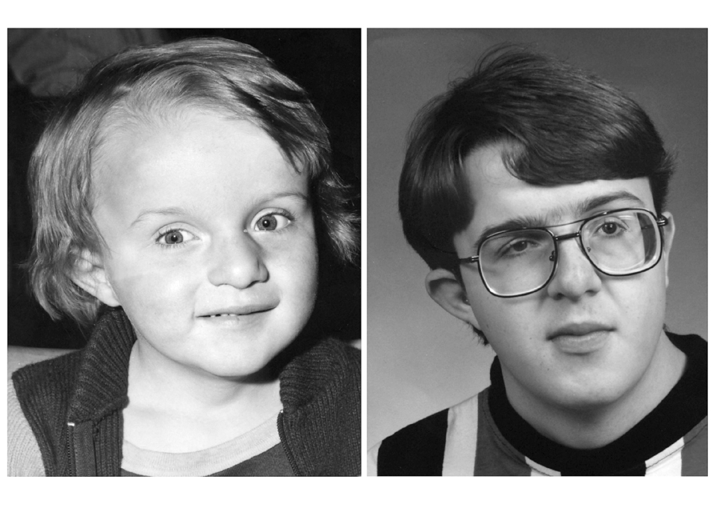
CHARGE Syndrome from Birth to Adulthood: an individual reported on from 0 - 33 years.
Searle et al American Journal of Medical Genetics 2005:113A(3), 344-349.

Slide 57
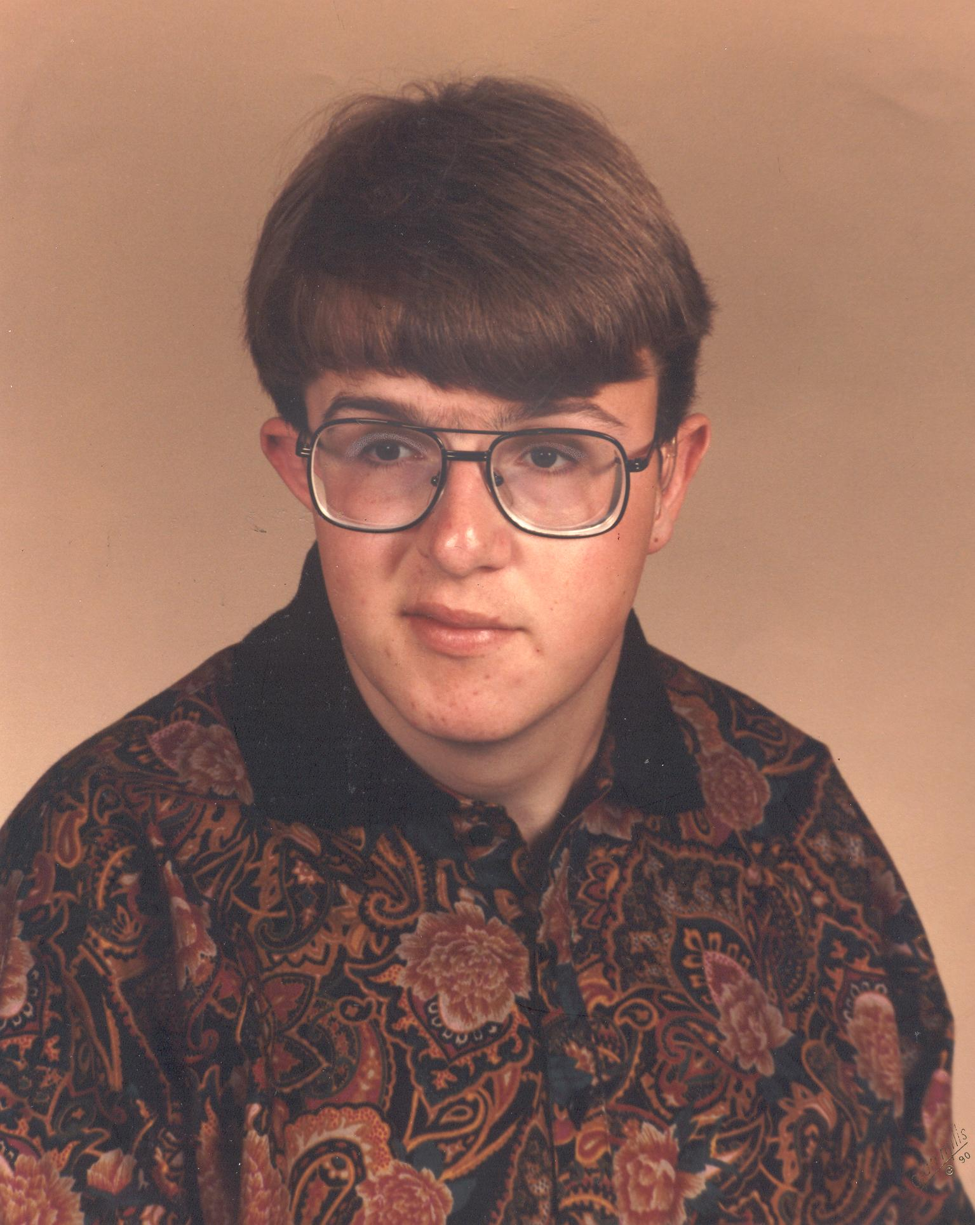
Adolescent and Adult Issues
Hormone replacement therapy (14-21 years)
Thyroid replacement (19 years)
Gallstones removed
Reflux oesophagitis, stricture and hiatus hernia
Osteoporosis

Slide 58

What is Osteoporosis?
Bone is a living tissue
Calcium and Phosphate (CaPo₄) [Mineral]
Collagen [Protein]
Demineralization of bone and/or thinning of bone.

Slide 59

Risk Factors for Osteoporosis in Individuals with CHARGE
Delayed/absent puberty.
Poor diet (low Ca ²⁺ & Vitamin D intake).
Inactivity
Growth hormone deficiency.

Slide 60


To Measures Bone Density
Dual Energy X-ray Absorptiometry (DEXA or DXA)
Late 1980’s postmenopausal women
1990’s development of validation software
Different DEXA manufacturers, different modules, different software analysis = different numbers

Slide 61


Investigation of Osteoporosis – DEXA Scan
The more negative the score the more severe the bone mineral density loss.
T = -3.19
Z = -2.97
T = -3.97
Z = -3.97
T < - 1 SD Osteopenia
T < - 2.5 SD Osteoporosis
T Score compares the observed BMD with that of the adult.
Use Z scores in children

Slide 62


Risk Factors for Poor Bone Health in Adolescents and Adults with CHARGE Syndrome
Actual Age 17 Years
L wrist & Hand X-ray
12 Years
Bone Age: 92.3% (13/14) of individuals showed delays in bone age ranging from 2-8 years (assessed by L. wrist x-ray).
Karen E. Forward, Elizabeth A. Cummings, and Kim D. Blake. American Journal of Medical Genetics Part A 143A:839–845 (2007)

Slide 63


Results : Spine and Fractures
Scoliosis (53.3%)
Kyphosis (16.7%)
Bony Fractures (30%)
Scoliosis in CHARGE syndrome Doyle C, Blake KD,. AJMG. 133A:340-343. 2005.

Slide 64
Results: Nutrition
Calcium and Vitamin D Intake is Not Adequate
Calcium:
50% of adolescents and adults failed to meet the Recommended Daily Allowance (RDA) for Calcium.
Vitamin D:
87% of adolescents and adults failed to meet the RDA for vitamin D.
53% of population used a gastrostomy tube. (mean age removed 8 +/- 6.5 yrs)

Slide 65
Adolescents with CHARGE are less Active
Habitual Activity Estimation 13-18 yrs
Age 13-18:
CHARGE (n=14): 15.86 ± 1.46 yrs
Controls (n=38): 15.13 ± 1.23 yrs
Habitual Activity Estimation 19+ yrs
Age 19+:
CHARGE (n=11): 22.27 ± 3.07 yrs
Controls (n=27): 25.11 ± 3.14 yrs
Blue CHARGE
Red Controls

Slide 66



DEXA Scan of AH – Age 27 years
T = -3.19
Z = -2.97
In adults - Bone mineral density T-score <-2.5 SD
= osteoporosis.

Slide 67





Osteoporosis - Prevention
Adequate Calcium in Diet
(from all sources diet and supplements)
Pre-pubertal (4-8 years) 800 mg/day
Adolescents (9-18 years) 1300 mg/day
Adults 1000 mg /day

Slide 68



Osteoporosis - Prevention
Adequate Vitamin D
800 IU (international Units)*
Food rich in Vitamin D: sardines, herring, mackerel, salmon and fish oils (halibut and cod liver oils)
This may be an under estimate of vitamin D, especially in Northern climates

Slide 69


Exercises
To increase BMD, exercise must be weight bearing
Osteogenesis (bone accumulation) occurs under mechanical loading (Madsen 1998)
Elite swimmers have no increase in lumbar spine BMD compared to sedentary individuals (Bachrach 2000, Madsen Speckes 2001)
Great for balance but not for Bone Mineral Density (BMD)

Slide 70
Prevention of Osteoporosis in CHARGE Syndrome
Adequate diet and exercise*
Regular follow up with an endocrinologist for height, weight and pubertal status
Sex Hormone replacement therapy
  Testosterone in boys start at low dosage
  Low dosage estrogens in females
  *Seek physiotherapy, recreational therapy

Slide 71
Osteoporosis Treatment
Recommended Daily Allowance of Calcium 1300 mg
800 IU Vitamin D
Hormone replacement therapy
Bisphosphonates and raloxifene are the first line treatment in postmenopausal females… few studies in children

Slide 72

Thanks! – Questions?

