Slide 1


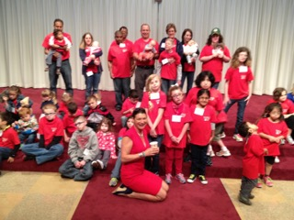
Those GUT Feelings!
Cranial Nerves & the GI System in
CHARGE Syndrome
Dr. Kim Blake
Professor Pediatrics
IWK Health Centre and Dalhousie University
kblake@dal.ca
Navasota, Texas, 2015

Slide 2
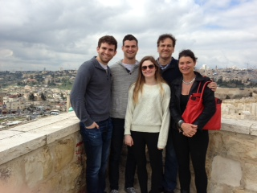
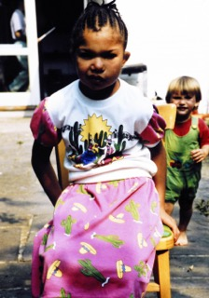
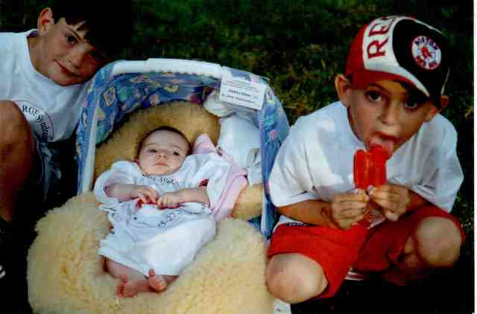
Blake / Ur Family
Boston 1997, CHARGE Conference
UK 1990, family CHARGE picnic

Slide 3
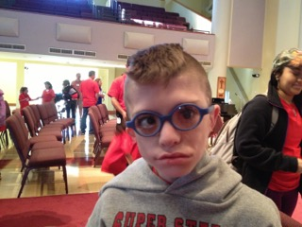
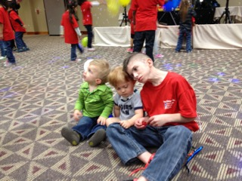
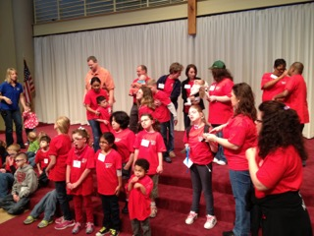
Texax 2013
No conflict of interest

Slide 4
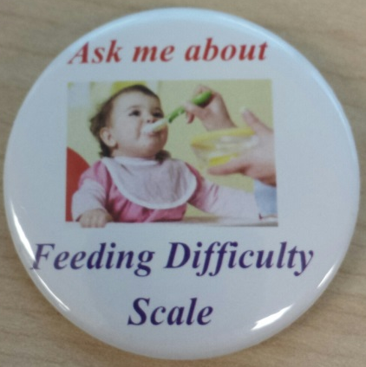
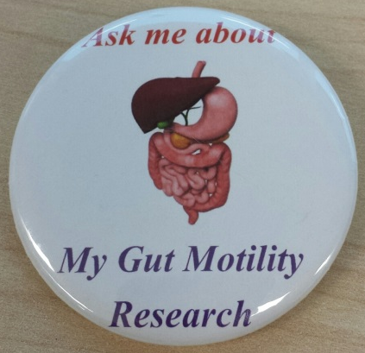
Objectives
After this presentation you will have a better understanding of the gut motility issues in CHARGE Syndrome including:
  Pocketing and over stuffing
  Recent research with Zebrafish
  You will gain an awareness of where cranial nerves fit into CHARGE Syndrome
  I will offer some hypothesis about the gut micro biotic and it’s relation to CHARGE Syndrome

Slide 5
Let’s Rate Your CHARGEr’s Eating & Swallowing Difficulties Over the Years
0 | 1 | 2 | 3 | 4
None | A little (reflux, choking, no G or J tubes) | G or J Tube, less than 12 months | G or J tube feeding more than 12 months | Extension difficulties, one of the biggest problems

Slide 6
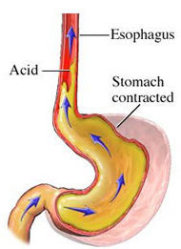
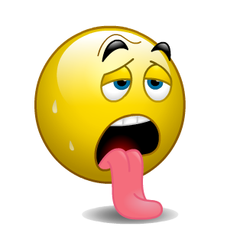
Gastroesophageal Reflux

Slide 7
Treatments for Gastroesophageal Reflux Disease (GER)
Behavioral treatment – raising the bed, small frequent meals, limiting foods that promote reflux such as tomatoes, meat, chocolate.
Medical management
  Ranitidine 8mg/kg per day in 2-3 divided doses
  Prevacid (lansoprazole)- 1-2 mg/kg per day at the beginning of the day, 20 minutes before breakfast
  Domperidone (Motilium) – 3-4 times a day before meals (watch for side effects)
  Cisapride (Propulsid) special authorization

Slide 8
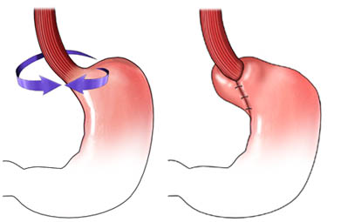
When Medications Fail, What is Next? Surgery - Fundoplication
http://uvahealth.com/
But is the problem more than just reflux?

Slide 9
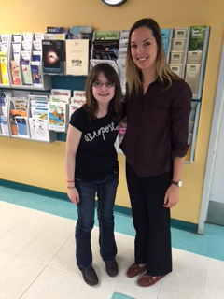
Mouth Over-stuffing and Pocketing of Food in Individuals with CHARGE Syndrome
MacKenzie Colp & Alex Hudson at the IWK, 2015

Slide 10


Mouth Over-Stuffing and
Food Pocketing
Parents of children/adults with CHARGE syndrome who mouth over-stuff and/or food pocket
  45 minute interview
  Feeding/Swallowing Impact Survey
Interviewed 20 parents of individuals aged 2 – 32 years old
From Canada, USA, Europe, Australia, New Zealand
IWK Study 2015 - 2016

Slide 11


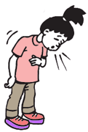
Highlighted Issues
Increased risk of choking
Have to have someone with the child when eating
Increased time to finish eating
Over stuffing can begin at any age
Risk of cavities
Oral cavity hyposensitivity

Slide 12


Food Pocketing
In their cheek (n=15, 75%)
In their palate (n=2, 10%)
Food pocketed 1-2 hours after the meal had ended (n=7, 35%)

Slide 13

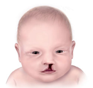
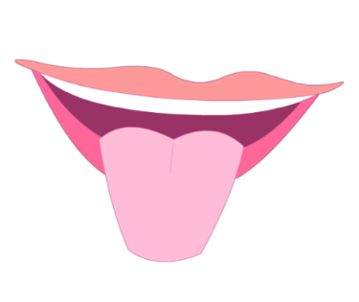
Characteristics That May Influence Food Pocketing
1) Cranial nerve dysfunction
  More likely to have to remind to swallow (p=0.007)
  More likely to take a long time to eat (p=0.03)
2) Cleft palates
  8 had a cleft palate
  1 had a submucosal cleft
  4 had a medically diagnosed high palate
3) Tongue movement abnormalities
  moving tongue forward out of mouth
  using tongue to move food around

Slide 14
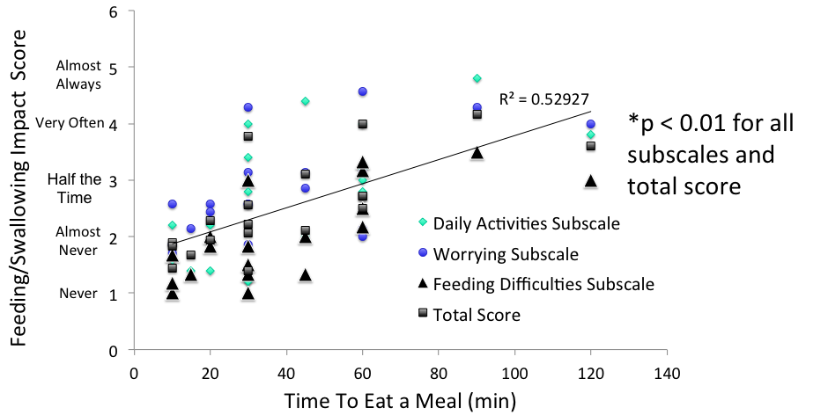
Longer Time to Eat Correlated with a Higher Impact on Caregivers

Slide 15
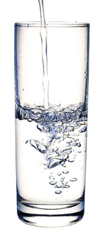
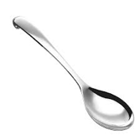
Parent’s Tips & Tricks
Remind to chew and swallow and finish what’s in their mouth – then take more from plate
Use a water or liquid chaser while eating
Use favorite foods as incentives to eat other foods
Serve food textures that work well (e.g. purees)
Have puree and solid food options at the same meal
Cut food into really tiny pieces
Use a smaller spoon

Slide 16

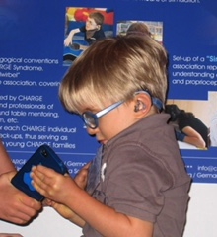
Parent’s Tips & Tricks
Have your child eat with you at the normal table
Use an iPad or TV show to distract while eating
External pacing / therapist input
Give one item / one bite at a time

Slide 17
Parent Quotes
Sensory
“Yes, often I have her come home from school on the bus and I find bits of whatever she’s had for snack at school in her cheeks.”
“overstuffing and pocketing – it is only in her palsy side. Her side that works, she does not pocket food whatsoever”
Behavioral
“Because she is too smart for her own good, giving her a water chaser…is ineffective because she swallows the water around the food”

Slide 18
Conclusions
Mouth over-stuffing and food pocketing can begin at any age
Can happen in those who never needed a G/J tube
A long time to eat a meal may indicate problems with food pocketing
These feeding behaviors can cause parents to worry
Can lead to choking, teeth decay, and other consequences
Individualized feeding evaluation is needed!
Study submitted to Dysphagia Sept. 2015

Slide 19

Abdominal Pain
Reflux
Bloating
Difficulty with digestion
Abdominal migraine
Constipation
Non organic

Slide 20
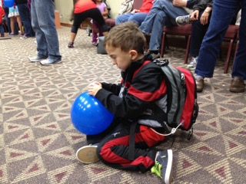
Treatment Suggestions
Triggers for migraine
Venting G-Tubes
Massage
Diet
Motility agents
David Brown has spoken on colon massage

Slide 21
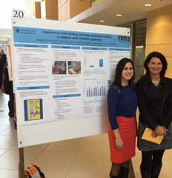
Experience with Feeding and Gastrointestinal Motility in Children with CHARGE Syndrome
Meghan & Kim at the Research in Medicine (RIM) Presentations at Dalhousie University 2015

Slide 22
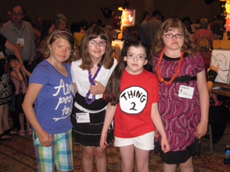
Questionnaires
CHARGE characteristics
Feeding Severity
Gastrointestinal symptoms
Transition to oral feeding
Toilet training
Reflux
Bloating
constipation

Slide 23
Results
Participants: 69
  Current age: 1-18 years (avg. 7.87 y)
  Age of CHARGE diagnosis: in utero – 2 years
  Gender: 58% (n=40) Female, 39% (n=27) Male, 3% (n=2) unreported
  Country: North America 45% (n=31), Europe 39% (n=27), NZ/AUS 13% (n=9), Asia 1.5% (n=1), Unknown 1.5% (n=1)
  Gene CHD7:
    Positive 66% (n=44)
    Negative 9% (n=6)
    Not tested 25% (n=17)
Notes:
We had 69 participants from around the world including 27 from Europe. Ages ranged from 1 to 18 with an average age of close to 8 years old. Based on the CHARGE characteristic data, our population was very representative of a typical CHARGE population. All participants were either CHD7 gene positive or met the clinical criteria for a CHARGE syndrome diagnosis.

Slide 24
Pediatric Assessment Scale for Severe Feeding Problems (PASSFP)
*
*
*
Lower score indicates more severe feeding difficulties (range 6-61)
(* indicated statistically significant mean PASSFP scores)
Notes:
The pediatric assessment scale for severe feeding problems was designed and validated at the IWK in Nova Scotia. This questionnaire found that in our population, children who were tube fed had worse feeding problems than those children who were partially tube and oral fed. Children who were partially orally fed, had worse feeding problem than children who were completely orally fed.

Slide 25
PedsQL Gastrointestinal Symptoms Scale
Lower score indicated greater GI symptoms
Domain: 1 Stomach Pain(*) 6 Nausea and vomiting(*)
2 Discomfort when eating(*) 7 Gas and bloating(*)
3 Trouble swallowing(*) 8 Constipation(*)
4 Food and drink limits(*) 9 Blood in poop
5 Heartburn and reflux 10 Diarrhea

Slide 26
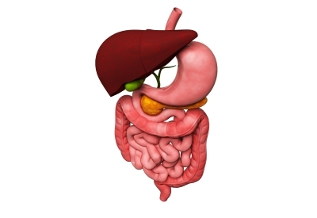
Short Answer Questions
CHARGE characteristics linked to greater GI symptoms:
  Choanal atresia/stenosis
  Cranial nerve IX, X dysfunction
Transition to oral eating challenges
  Lack of biting/chewing
  Choking
  Mouth overstuffing
Notes:
The short answer questions provided a wealth of information. To briefly summarize, children with choanal atresia or stenosis had greater GI symptoms than those without. In addition, those with cranial nerve IX and X dysfunction also had worse GI symptoms than those without. No other CHARGE characteristic information was associated with GI symptoms.
While the transition from tube to oral feeding was variable, the common challenges identified were lacking of biting and chewing, choking, and mouth overstuffing or pocketing.

Slide 27
Short Answer Questions
Urine and bowel (day/night) occurs later than in typically developing children
  Helpful tips: positive reinforcement, prompts
Major feeding challenges
  Bowel regulation 30% (n=19 )
  Vomiting 19% (n=12)
  General feeding issues 17% (n=11)
  Choking 17% (n=11)
Despite medication use, constipation is rated as a major GI/motility challenge
Notes:
The toilet training data revealed that most training occurs later in age than typically developing children, closer to ages 5 through 7.
Parents identified bowel regulation, vomiting, general feeding issues including overstuffing, and choking as the greatest feeding challenges.

Slide 28
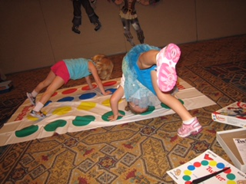
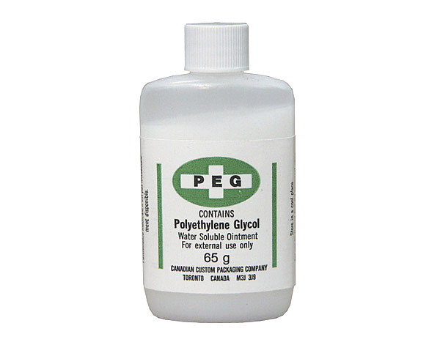
Prevention / Treatment for Constipation
Prevention:
Fluids
Exercise
Behavioural therapy
diet
Treatment:
Polyethylene glycol / PED / MiraLAX
Senocot
Behavioural techniques
Massage

Slide 29
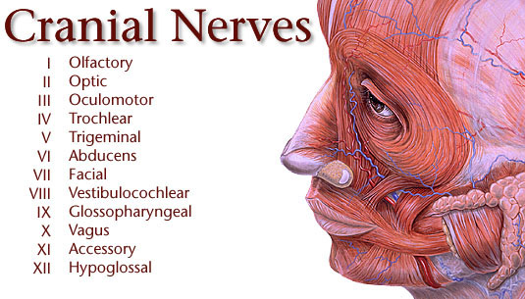
Yale Center for Advanced Instrumental Media’s Web Site: http://info.med.yale.edu/caim/cnerves

Slide 30
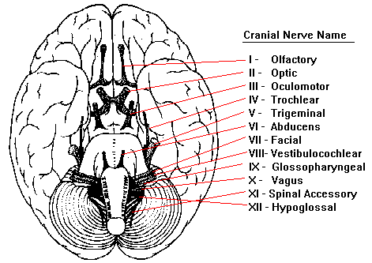
Cranial Nerves Arising from Base of Brain
Tenth Edition Grant’s Atlas of Anatomy

Slide 31

How Many of You Have CHARGEr’s with Suspected Cranial Nerve Problems?
No
1
2
3
More
CHARGE hands up

Slide 32
Cranial Nerves
These guys direct the traffic & run the show
Name | What It Does
I Olfactory | Smell
II, III, IV, VI | Eye control
V Trigeminal | Chewing, sensory for facial regions; sensations in the sinuses, the palate and the upper lip, the jaw, mouth and tongue.
VII Facial | Facial movements, taste, salivation
VIII Vestibulocochlear | Hearing, balance
IX Glossopharyngeal | Taste, salivation, swallow; some visceral
X Vagus | Phonation, swallow; important visceral
XI Spinal Accessory | Moves head & shoulders; laryngeal muscles
XII Hypoglossal | Movement of the tongue
11th International CHARGE Conference Kate Beals & Kim Blake

Slide 33
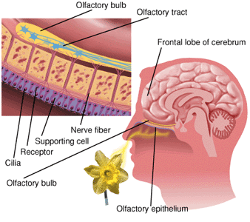
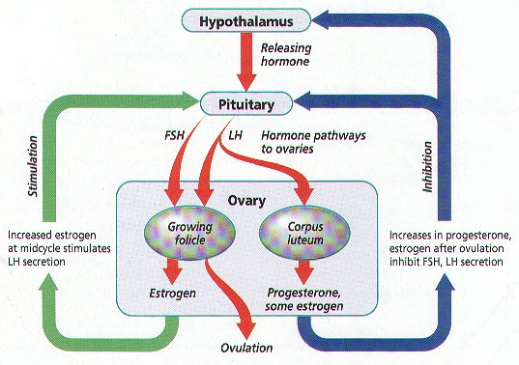
Olfactory Nerve (CN I)
Chalouhi C, Faulcon P, Le Bihan C, Hertz-Pannier L, Bonfils P, Abadie V. Olfactory evaluation in children: application to the CHARGE syndrome. Pediatrics 2005

Slide 34
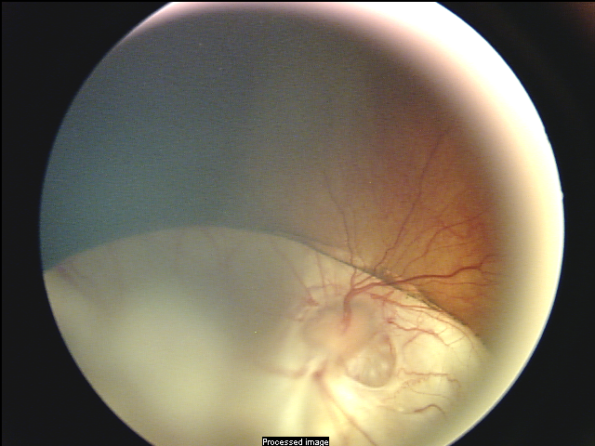
Retinal Nerve Coloboma
The Cranial Nerves of the Eye
II | Optic
III, IV, VI | Eye muscle movement
In CHARGE syndrome visual perception (II) affected, less often eye movement.
McMain K, Blake K, Smith I, Johnson J, Wood E, Tremblay R, Robitaille J.
Ocular features of CHARGE syndrome. 2008 Oct;12(5):460-5.

Slide 35
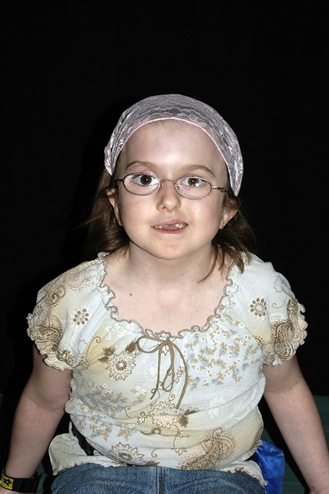
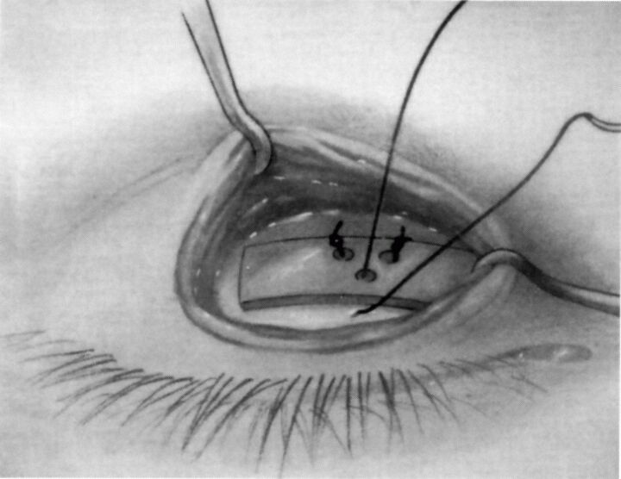
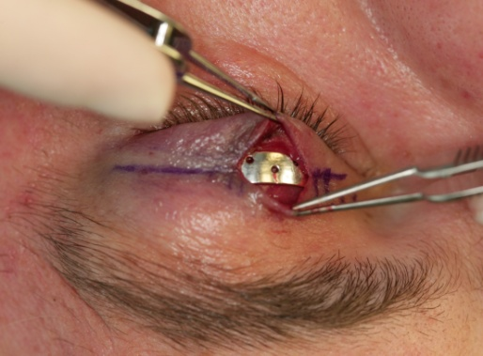
Eyes are at Risk With Facial Palsy
Dry eye
Damaged cornea
Light sensitivity
Using weights in the eyelids

Slide 36
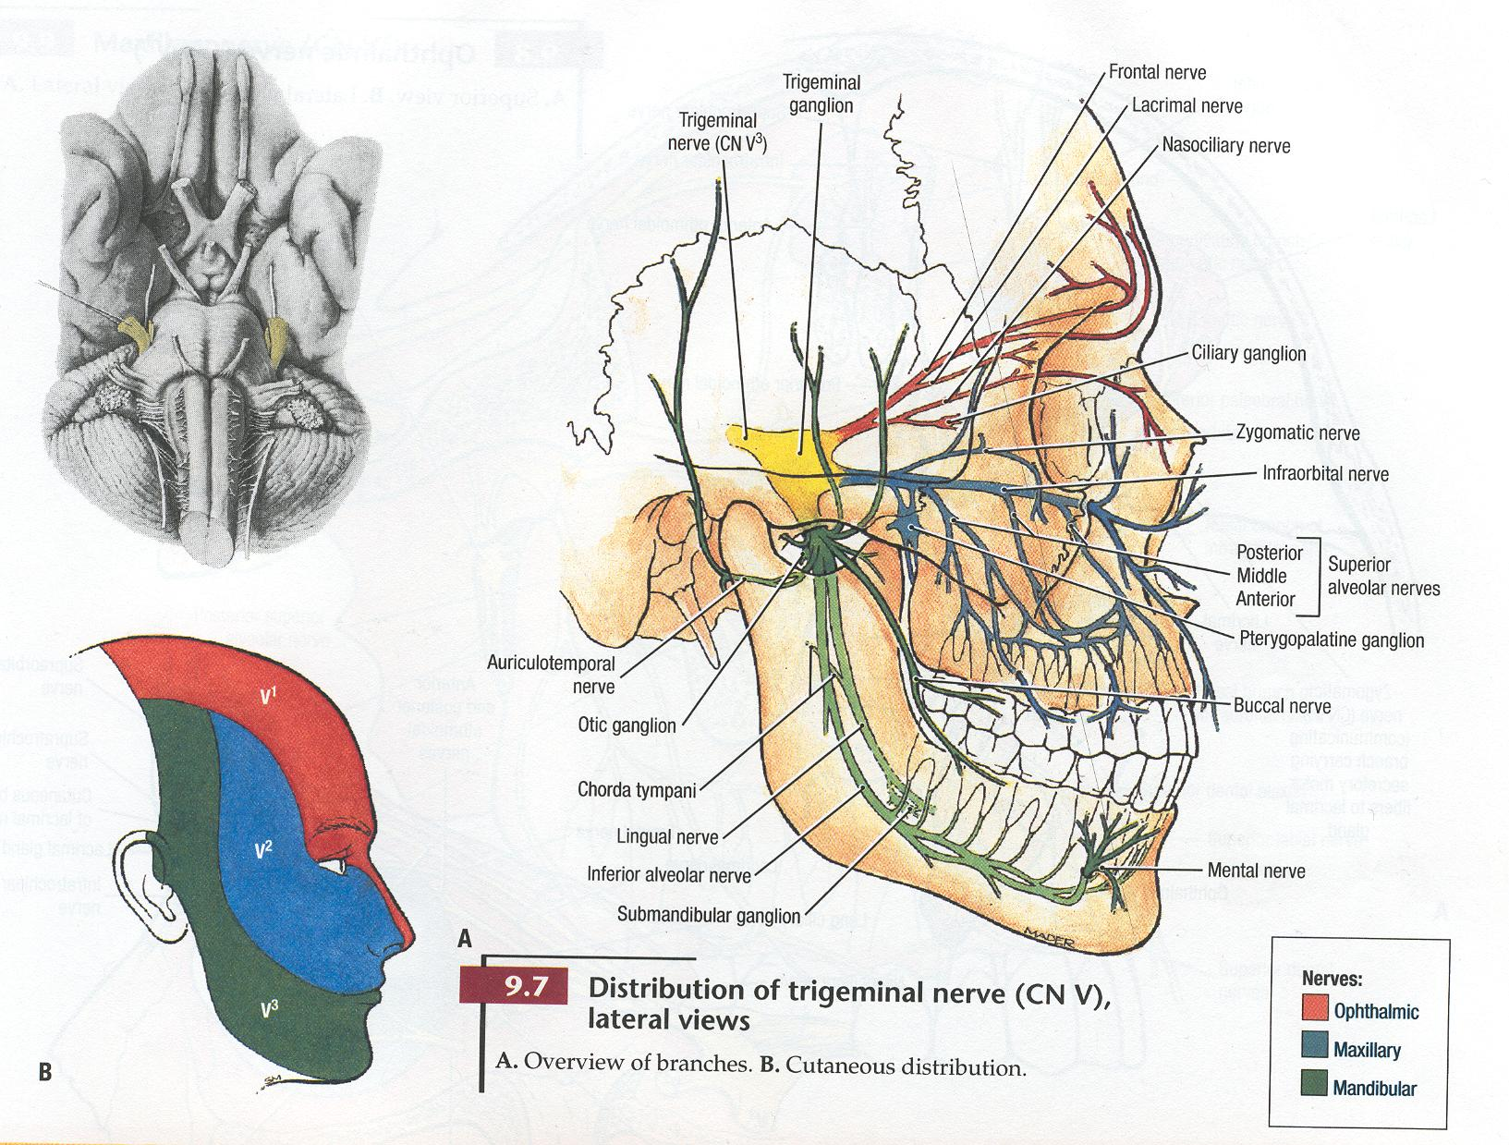
Trigeminal Nerve (CN V)
Tenth Edition Grant’s Atlas of Anatomy

Slide 37
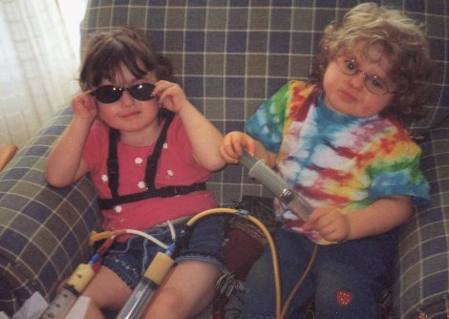
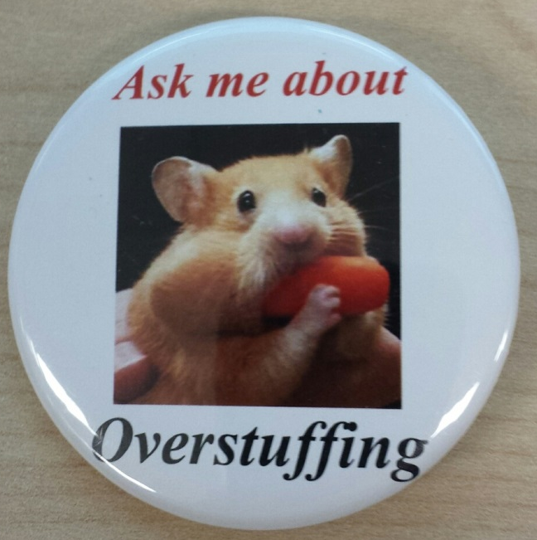
Feeding issues are often severe.
Muscles of Mastication – Cranial Nerve V
Two friends, MC and KW, having lunch.

Slide 38
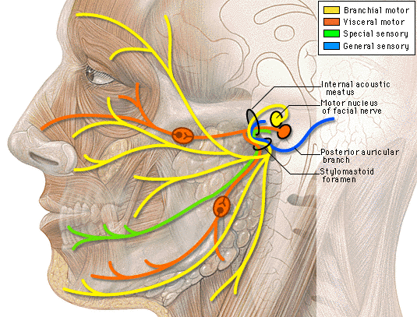
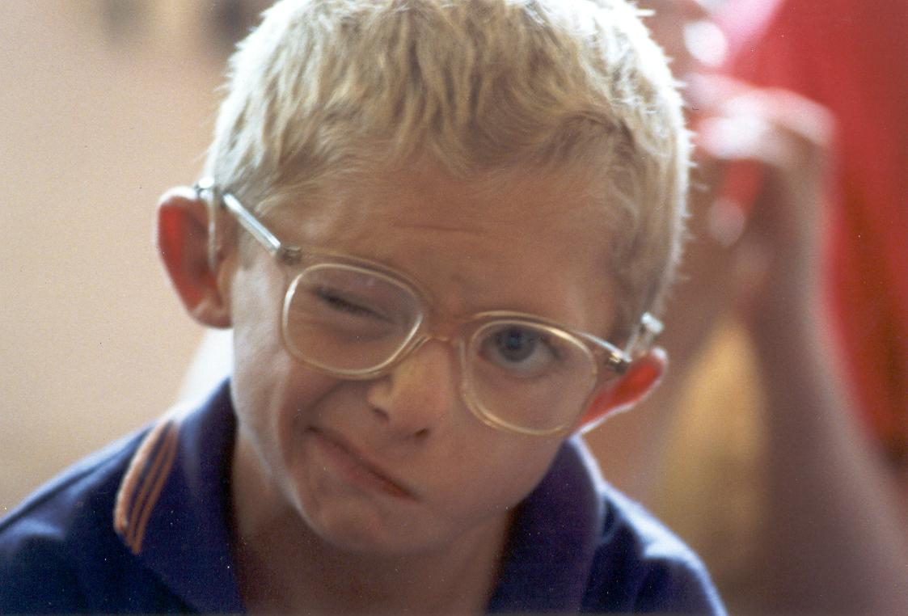
Cranial Nerve VII - Facial
UK, 2001
http://info.med.yale.edu/caim/cnerves

Slide 39
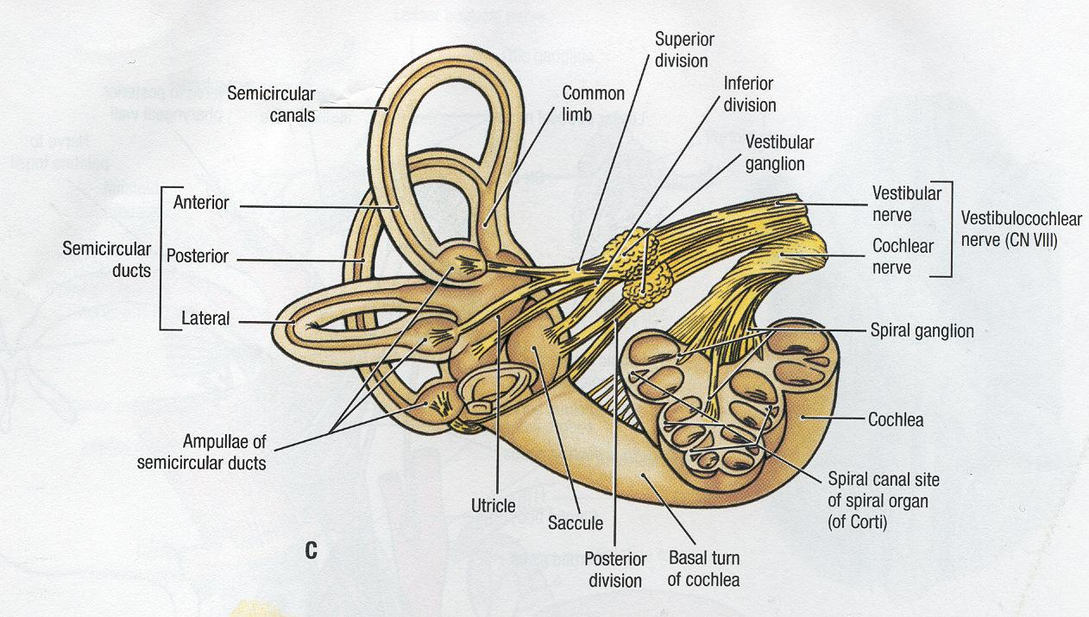
Temporal Bones – Balance & Hearing (CN VIII)
Tenth Edition Grant’s Atlas of Anatomy

Slide 40
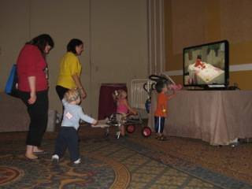
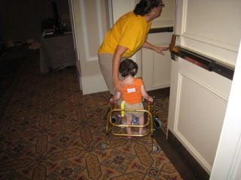
Mobility & balance in CHARGE has improved with physiotherapy
International CHARGE Conference 2011

Slide 41
Lower Cranial Nerves IX-XII
Cranial Nerve | Function | Symptom of Dysfunction
IX | Taste Salivation Swallowing | Gag reflex Swallowing
X | Phonation Swallowing | Gag reflex Swallowing
XI | Head and shoulder movement Laryngeal muscles | Shoulder drop Winging scapula
XII | Tongue movements | Pocketing food, loss speech
IX X XI Cranial Nerves – Abnormality in the supranuclear region.

Slide 42
The Cranial Nerves and Swallowing
Sensory IN
Motor OUT
V Trigeminal – Muscles of mastication (chewing)
IX Glossopharyngeal – Salivation and swallow
X Vagus – Swallow, visceral (gut & heart)
V Trigeminal – sensation in the palate, upper lip, jaw, mouth, and tongue.
XI Spinal Accessory – moves head and shoulders, laryngeal muscles
IX Glossopharyngeal – Taste
XII Hypoglossal – moves tongue
11th International CHARGE Conference Kate Beals & Kim Blake

Slide 43
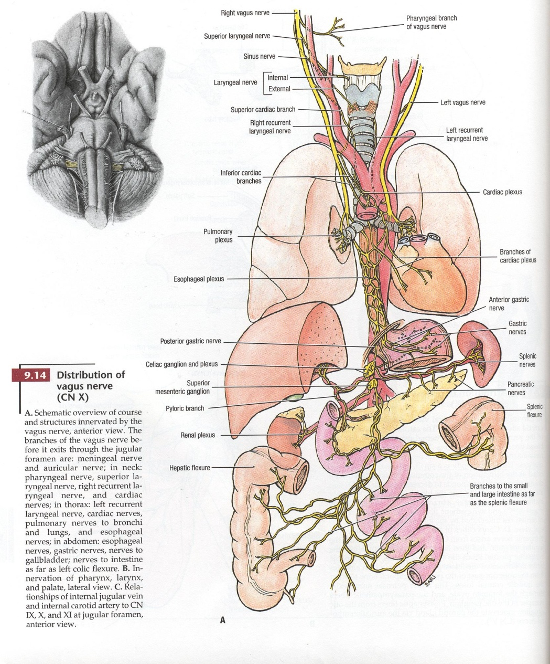
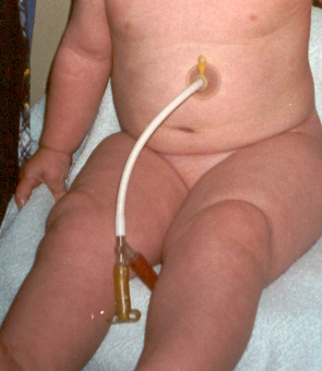
Cranial Nerve X
Vagus
Tenth Edition Grant’s Atlas of Anatomy

Slide 44
Summary of Cranial Nerve (CN) Findings in CHARGE syndrome
Dysfunction of cranial nerves is more frequent and multiple.
The extent and involvement of cranial nerves may reflect the clinical spectrum.
CN VII - is more frequently associated with other CN’s
- is seen in those individuals more severely affected.
CN V – “muscles of mastication” affected in CHARGE.
Structural brain malformations highly associated with CN.
Kim D. Blake, Timothy S. Hartshorne, Christopher Lawand, A. Nichole Dailor, and James W. Thelin. Cranial Nerve Manifestations in CHARGE Syndrome. AJMG Part A 2008, 146A pp 585-592

Slide 45
https://www.youtube.com/watch?v=1h2VW8USCAA

Slide 46
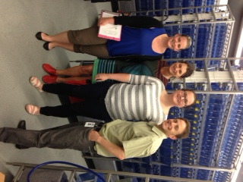

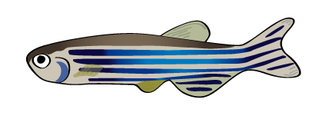
Research at IWK 2014 - 2016
Teaming up with Dr. Berman, who has expertise in modeling rare diseases in zebrafish, we are exploring three main areas of CHARGE syndrome:
1. Gut motility and function
2. Heart anomalies and genetics
3. Cranial nerve anomalies
Our 1st fish from Texas

Slide 47
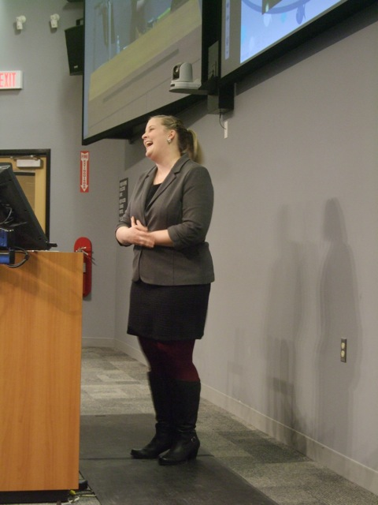
Modeling CHARGE Syndrome in Zebrafish: A Look at the Innvervation and Function of the Gastrointestinal System
Kellie Cloney presenting at the Dalhousie Research in Medicine (RIM) 2015. Award for Outstanding Platform Presentation.

Slide 48
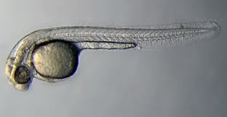
The Zebrafish
Zebrafish make an excellent model organism to study rare pediatric single gene diseases because:
  Conserved genetics
  Ease of genetic manipulation
  Embryonic transparency
  Rapid development

Slide 49
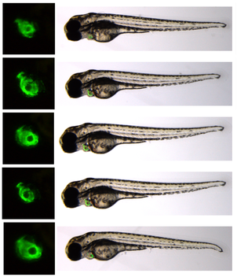
Zebrafish and CHARGE
CHD7 gene is conserved in the zebrafish
CHD7 knock down has demonstrated the following physiological effects in the zebrafish:
  Dysmorphic heart
  Smaller eyes
  Curvature of the body axis
  Disruption in the number, organization, and patterning of the cranial nerves (mainly V, VII, and X)
Notes:
1. Patten, S.A., Jacobs-McDaniels, N.L., Zaouter, C., Drapeau, P., Albertson, R.C. 2012. Role of chd7 in zebrafish: a model for CHARGE syndrome. PLoS ONE. 7(2): e31650.

Slide 50
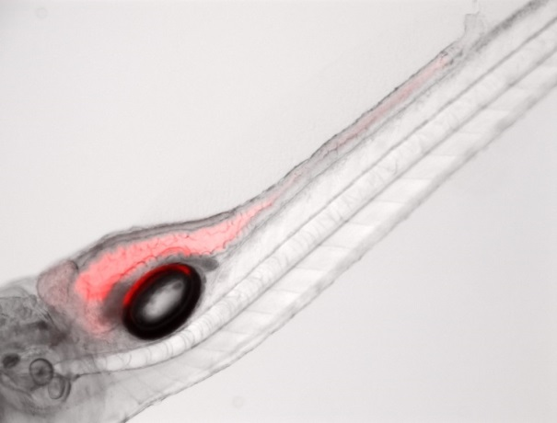



Nile Red Motility Study
A
B
C
D

Slide 51




Nile Red Motility Study –
CHD7 Morpholino
A
B
C
D

Slide 52

Immunohistochemistry
Early results demonstrate changes in the enteric innervation of the gastrointestinal track.
Changes in the ENS could lead to altered gut motility

Slide 53


Changes in motility seen with fluorescent microbeads
Brightfield View
0hr
6hr
24hr
Normal Fish
CHARGE fish

Slide 54
How will our Research Affect Individuals with CHARGE Syndrome
More emphasis on the gastrointestinal system (gastroenterologist feeding team)
Therapists with an understanding of the over-stuffing and pocketing phenomenon
Drug treatment to enhance motility of the gut

Slide 55
From the Zebra Fish Study we are Closer to Proving that the Vagus Nerve is Abnormal in CHARGE Syndrome
Cranial Nerve X Vagus
Tenth Edition Grant’s Atlas of Anatomy

Slide 56


Influence of Gut Microbes on the Brain
JAMA May 5, 2015 V313, 17

Slide 57

Therapeutic potential of bacteria in modulating brain behaviour
Role of Vagus nerve in mediating motility

Slide 58


Thank you!
To Our Young
CHARGE Researchers
and You!
Questions:
Notes:
Picture Reference: Kelsey et al 2013. ENU-induced Mutation in the DNA-binding Domain of KLF3 Reveals Important Roles for KLF3 in Cardiovascular Development and Function in Mice. PLOS Genetics. DOI: 10.1371.

